Slide 1


Slide 2
Overview
Some Puzzles About Matter
Using Antimatter to Learn About Matter
Physics Topics to be Studied at PANDA
Overview of PANDA Detector
Summary/Conclusions

Slide 3
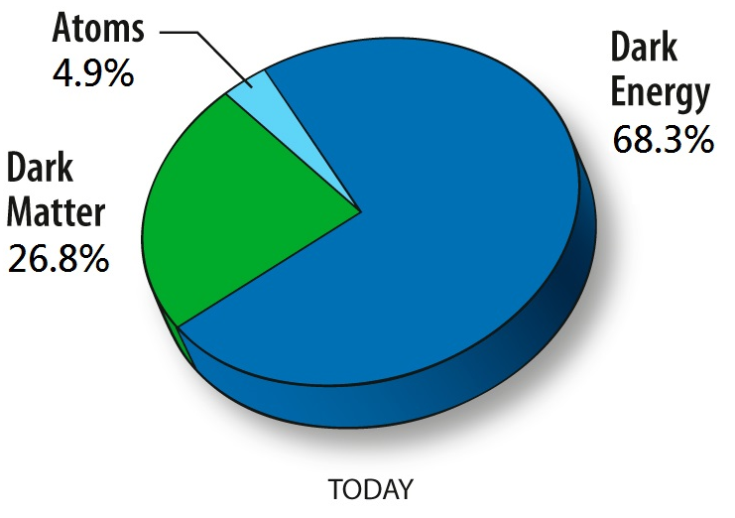
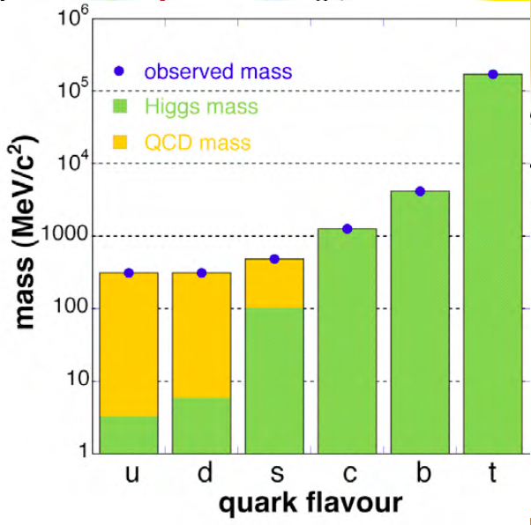
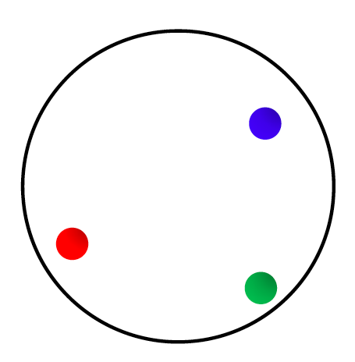
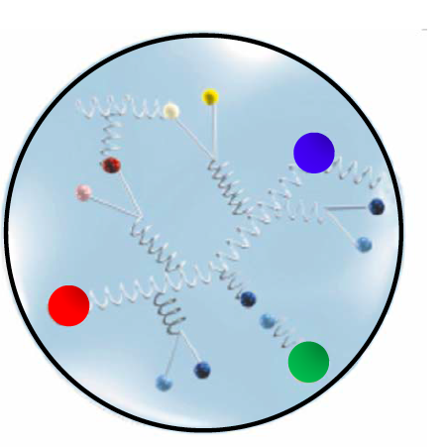
Puzzle One: Hadronic Mass
Visible matter is mostly atoms:
The total is the sum of the parts
  True to ~10⁻⁸ for an atom
  True to ~10⁻² for nuclei
  Wrong by x100 for nucleons (protons and neutrons)!

Slide 4
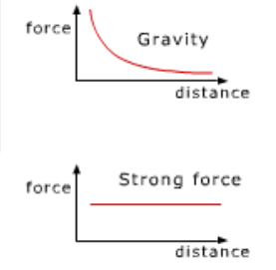

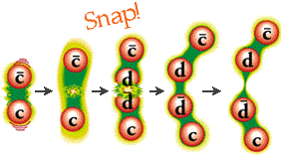
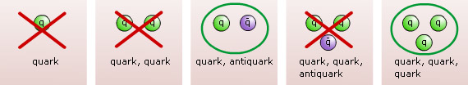
Puzzle Two: Why Only Some Types of Hadrons?
Strong force: only “color neutral” objects (confinement)
Mesons and baryons are color neutral

Slide 5
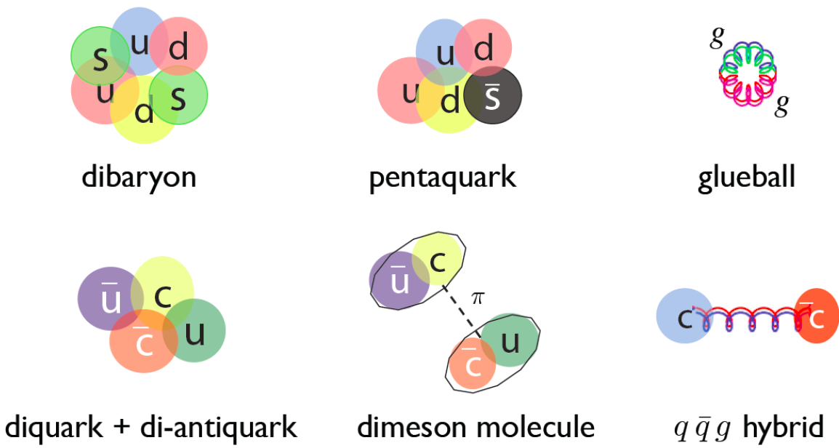
Puzzle Two: What About Other Combinations?
There are other ways to make color neutral objects:
Why do we see hundreds of mesons and baryons, but
it is not yet clear what the nature of some of the the new X,Y,Z states are?
(Zhu)

Slide 6
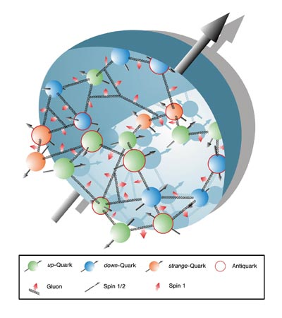
Puzzle Three: How are Properties of the
Whole Derived from the Constituents?
How do effective degrees of freedom emerge from the underlying theory (e.g. hadrons from quarks)?
What is the deep structure of
e.g. the nucleon?
How are its macroscopic properties
determined by partons?
Can we constrain theoretical approaches?

Slide 7
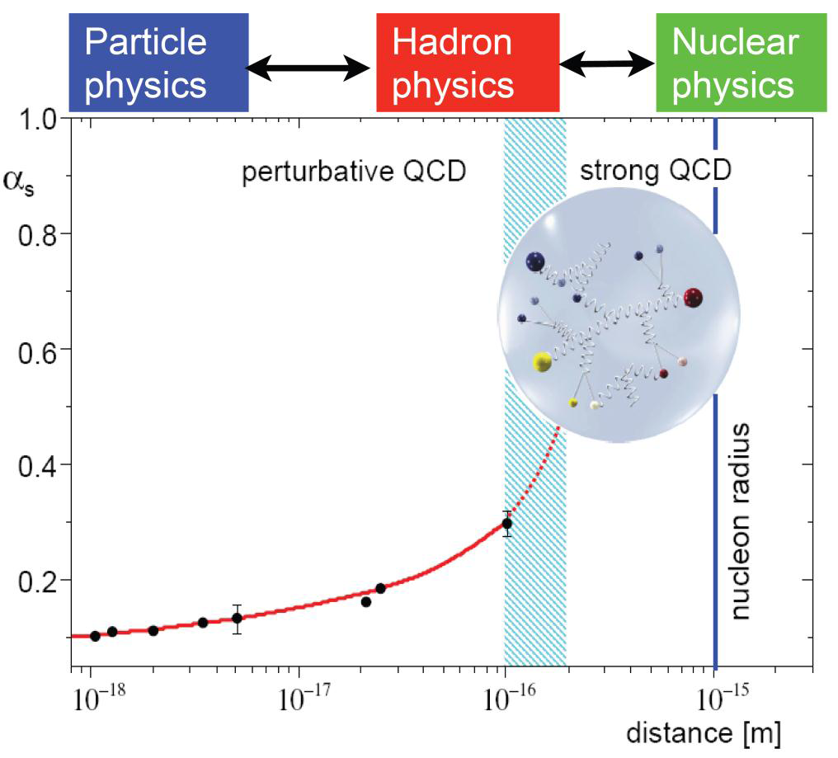
Hadron Physics with PANDA
QCD well understood at high Q²
Emergence of eff. DoF at low Q²
Phenomena appear that are hard
to predict from QCD:
e.g. confinement, nature of
hadrons, hadronic masses…
To gain further insight
precision experiments needed:
  Statistics
  Resolution
  Exclusiveness

Slide 8
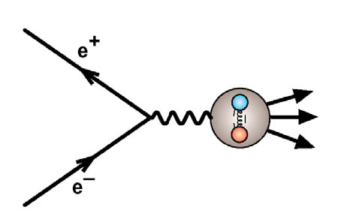
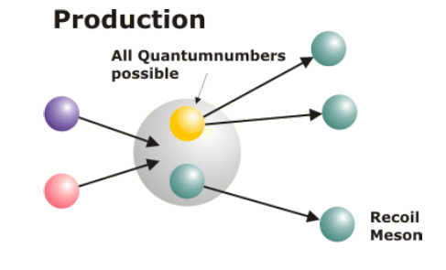
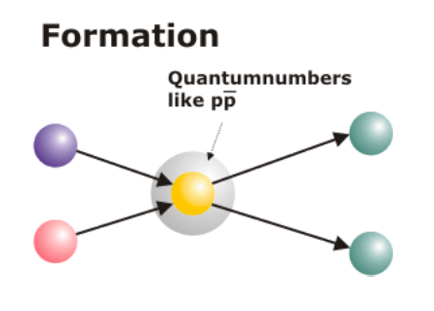
Why to Use Antiprotons ?
Annihilation is a gluon rich process
~2 GeV annihilation energy
“for free”
All fermion-antifermion quantum numbers accessible (compared to e⁺e⁻)
production reactions
Very high mass resolution in
formation reactions
High angular momentum accessible
J^{PC} = 1⁻⁻

Slide 9
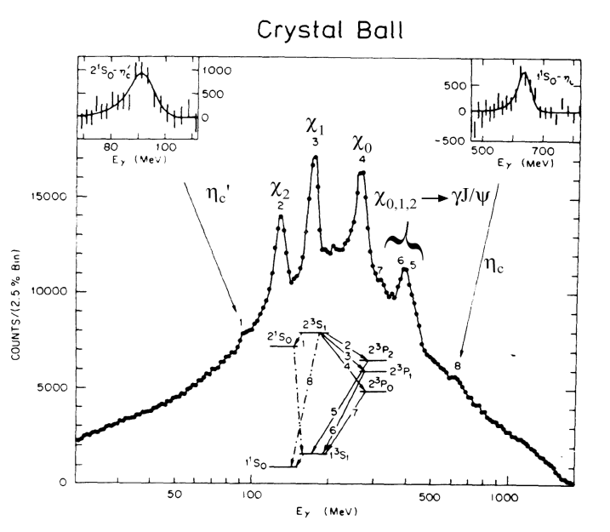
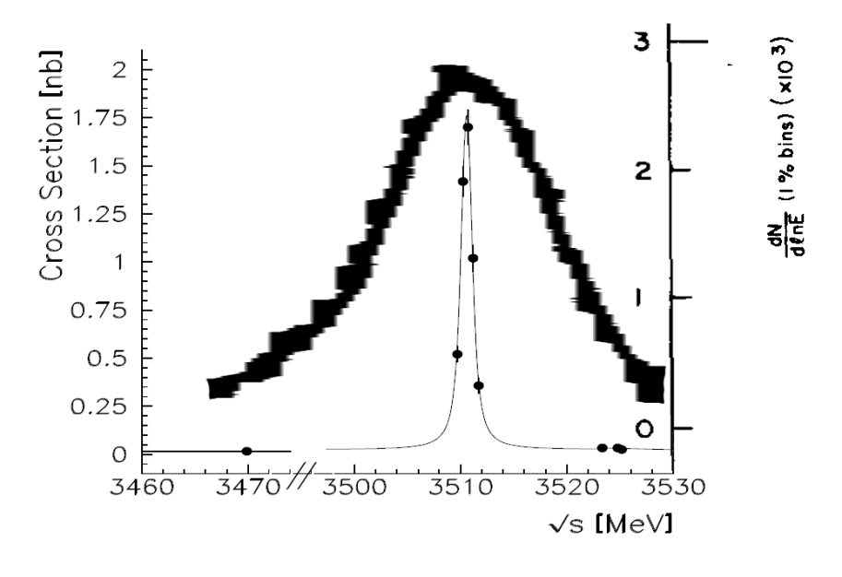
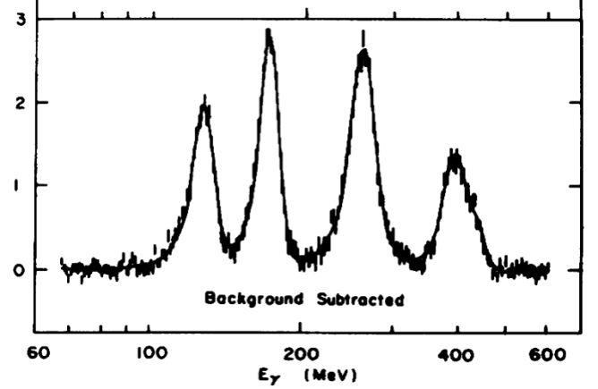
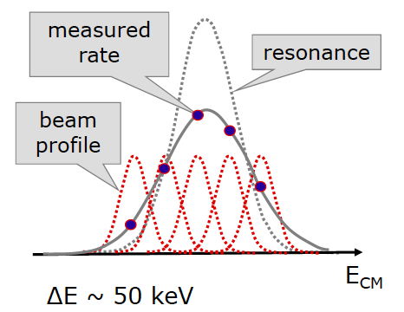
High Mass/Width Resolution, e.g.: χ_{c1,2}
Invariant mass reconstruction depends on the detector resolution ≈ 1 - 10 MeV
Formation:
Resonance scan: resolution depends
on the beam resolution
E760@Fermilab ≈ 240 keV
PANDA ≈ 50 keV

Slide 10
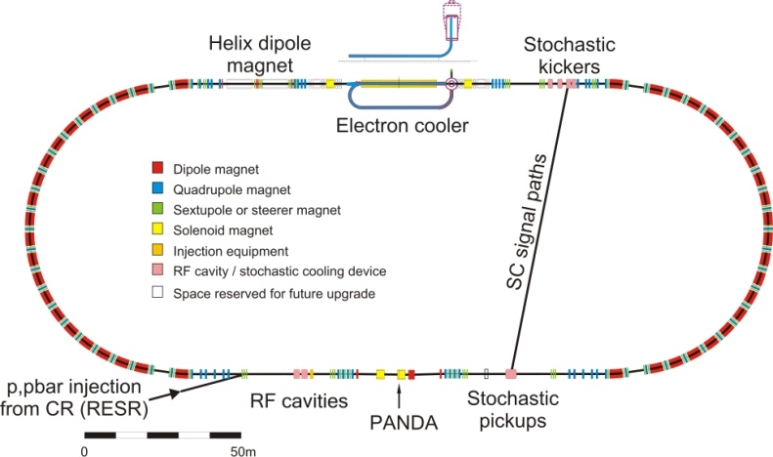
HESR with PANDA and Electron Cooler
10¹⁰ – 10¹¹ stored antiprotons
Thick targets 4·10¹⁵ cm⁻²
Δp/p ≤ 4·10⁻⁵
Lumi up to 2·10³² cm⁻²s⁻¹
HESR |  | COSY
575 m | Circumference | 184 m
1.5 – 15 GeV/c | Momentum | 0.3 – 3.7 GeV/c
up to 9 GeV/c | Electron Cooling | up to 0.5 GeV/c
Full range | Stochastic Cooling | 1.5 – 3.7 GeV/c
Notes:
10

Slide 11
_
PANDA Scientific Program
    Nucleon structure
    E.M. processes
    Meson spectroscopy
  light mesons
  charmonium
  exotic states
    glueballs
    hybrids
    molecules/multiquarks
  open charm
Baryon/antibaryon production
Charm in nuclei
Strangeness physics
  Hyperatoms
  S = -2 nuclear system
    Ξ⁻ nuclei
    ΛΛ hypernuclei
p Momentum [GeV/c]
0
2
4
6
8
10
12
15
ΛΛ
ΣΣ
ΞΞ
ΩΩ
DD
Λ_{c}Λ_{c}
Σ_{c}Σ_{c}
Ξ_{c}Ξ_{c}
Ω_{c}Ω_{c}
D_{s}D_{s}
qqqq
ccqq
nng,ssg
ccg
nng,ssg
ccg
ggg,gg
ggg
light qq
π,ρ,ω,f₂,K,K*
cc
J/ψ, η_{c}, χ_{cJ}
1
2
3
4
5
6
Mass [GeV/c²]

Slide 12
Hadron Structure with Electromagnetic Probes

Slide 13
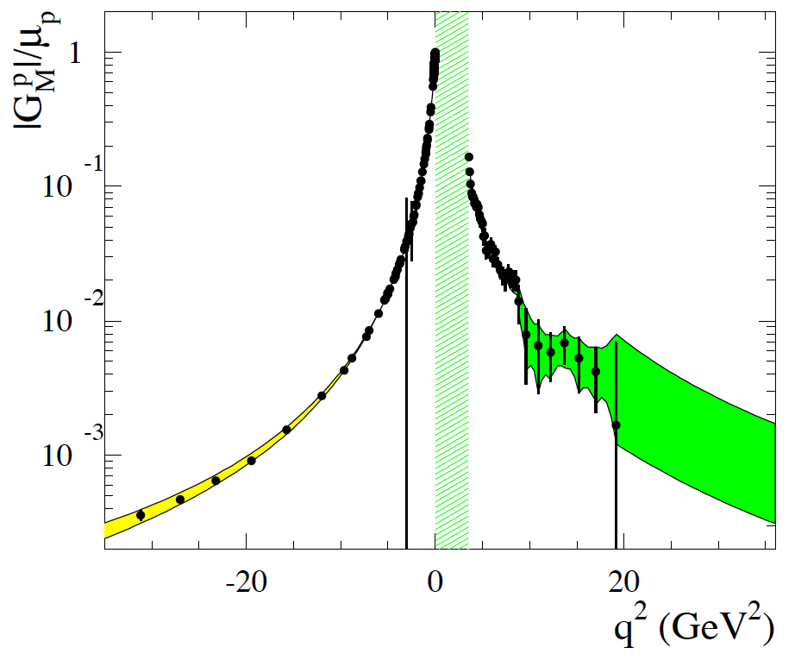
Time-Like& Space-Like EM Form Factors
electron scattering
annihilation pp↔ e⁺e⁻
q² > 4m_{p}²
-
e⁻ scattering ( Jlab…. A2/Mainz)
e⁺e⁻↔ pp (BES, Novosibirsk, PANDA)
10⁰
Spacelike
From S. Pacetti, arXiv:1012.1232v1
10⁻¹
Timelike
^{p}
G_{M}/μ_{p}
10⁻²
unphysical
10⁻³
-30
-20
-10
0
10
20
30
Dispersion relations:
q² < 0

Slide 14
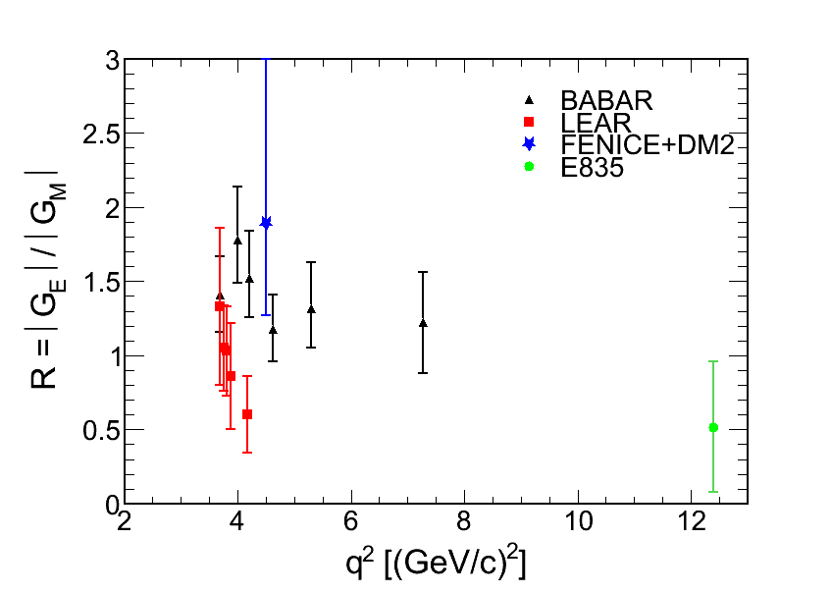
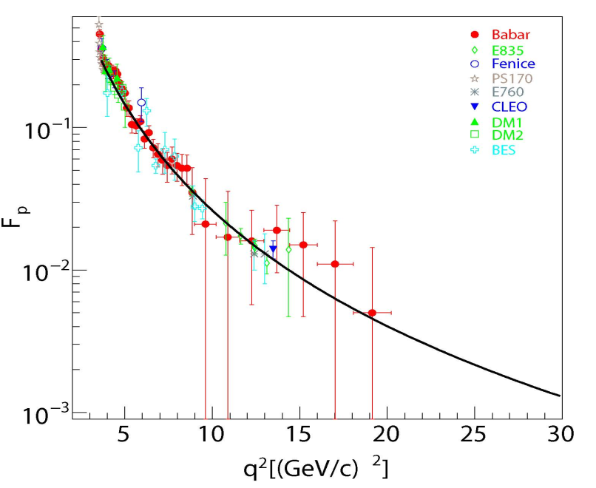
Proton EM Form Factors in Time-Like Region
_
_
Cross-sections: pp → e+e-
angular distributions: pp → e+e-
FENICE+DM2 (e+e-)
-
BABAR: (e+e- →ppγ)
-
-
LEAR (pp)
E835
(pp)
G_{eff}
4m_{p}2
G_{eff} : large error bars above 13 (GeV/c)²
|G_{E}/G_{M}| :
  Inconsistent data above threshold
  Lack of precise data above 5 (GeV/c)²
-
Notes:
In the Time-Like region, most of the experiments measured cross-sections either in epem or in pbarp annihilation , wich give access only to an effective form factor. Masurements have beeen performed up to 19 GeV/c2, but with a very poor precision. Only a few points could be obtained from angular distributions measurements, most of these points coming from the LEAR and BABAR experiments, but the precision is bad and in addition the two sets of data disagree, so that the information on the ratio of electric to magnetic form factor is rather poor in the Time-Like region.
In this context, the goal of the PANDA measurements is to measure both GE and GM up to large q2
1’10
Tot 11’10

Slide 15
Goal of PANDA Measurements
Extract Time-Like |G_{E}| and |G_{M}| for proton up to 14 (GeV/c)²
from lepton angular distributions in pp →e⁺e⁻ reaction
and measure G_{eff} up to 30 (GeV/c)²
-
-
Two major challenges:
Decrease of sensitivity to G_{E} with increasing q²
Huge hadronic background
σ (pp →π⁺π⁻) / σ (pp →e⁺e⁻) ~ 10⁶
-
-

Slide 16
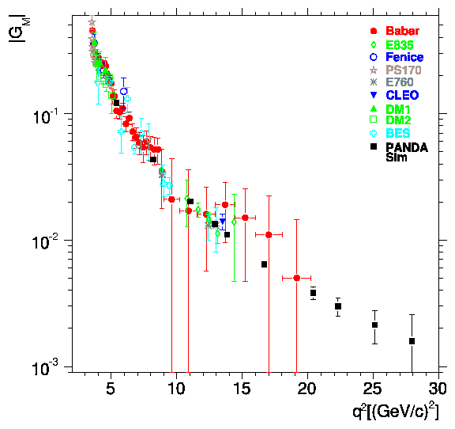
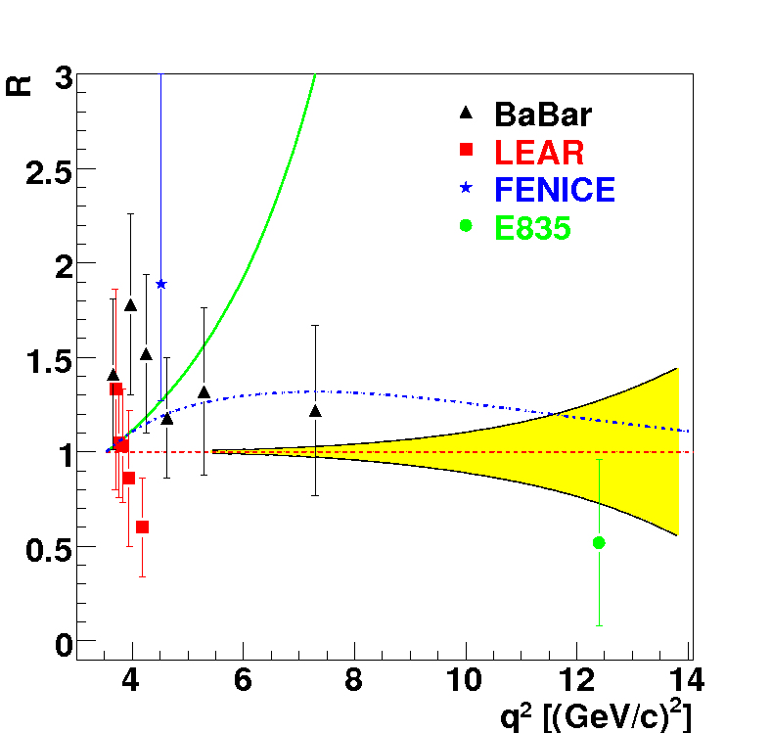
Time-Like Form Factor Measurement with PANDA : Estimates of Precision
L =2 fb⁻¹
Sudol et al. EPJA 44 (2010) 373
-VDM: F. Iachello et al., PLB43, 171 (1973)
…extended VDM, PRC66, 045501 (2002)
Egle Tomasi-Gustafsson et al., EPJA24 (2005) 419
G_{eff}
PANDA
PANDA
BES
BES
< 1% ~10% ~23% ~50%
pQCD ?
PANDA will bring
Precise determination of |G_{E}| and | G_{M} | up to 14 (GeV/c)²
G_{eff} up to 30 (GeV/c)² : transition towards perturbative QCD
Notes:
In this publication, we also evaluate the precision on the form factor measurement that will be achieved with PANDA and compare it to the existing data. The ratio of electric to magn FF can be measured up to 14 GeV/c2 from an analysis of the angular distributions with a good precision. This will improve very much the present experimental situation. In addition, it will allow to discriminate among models which are all able to reproduce the Geff and also the space like data, but give different predictions for the ratio GE/GM. Here we see for example the Iachello model in green, which predicts a very strong electric form factor.
Cross-sections and therefore the effective form factor can be measured with good precision up to 30 GeV/c2, which is the maximum available q2 at PANDA.

Slide 17
Charmonium-like Spectroscopy with Antiproton Annihilation

Slide 18
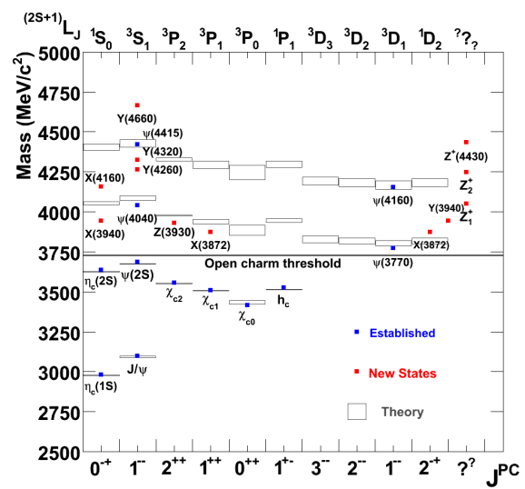
Charmonium Spectroscopy
New observations: We must go beyond simple quark models
new „XYZ“ states (Belle, BaBar, CLEO, CDF, D0, LHCb …)
  masses are poorly known;
  often widths are just upper limits;
  few final states have been studied;
  statistics are poor;
  quantum number assignment is possible for few states;
  some resonances need confirmation…
new degrees of freedom: molecules, tetraquarks, gluonic excitations?
open questions below DD threshold widths, branching
conventional states above DD
high L states:
access in pp but not in e⁺e⁻
_
_
_

Slide 19
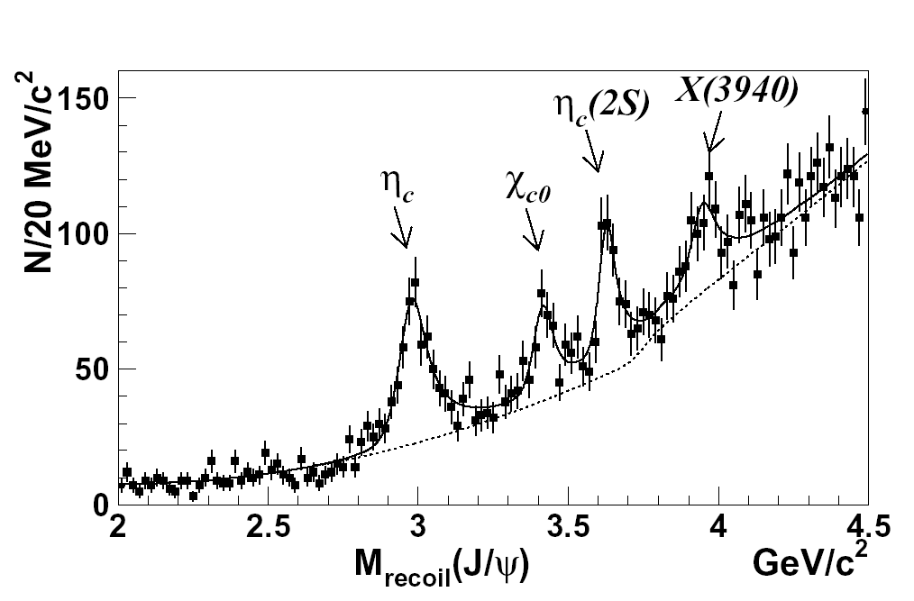
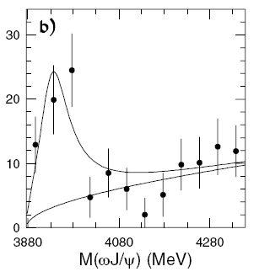

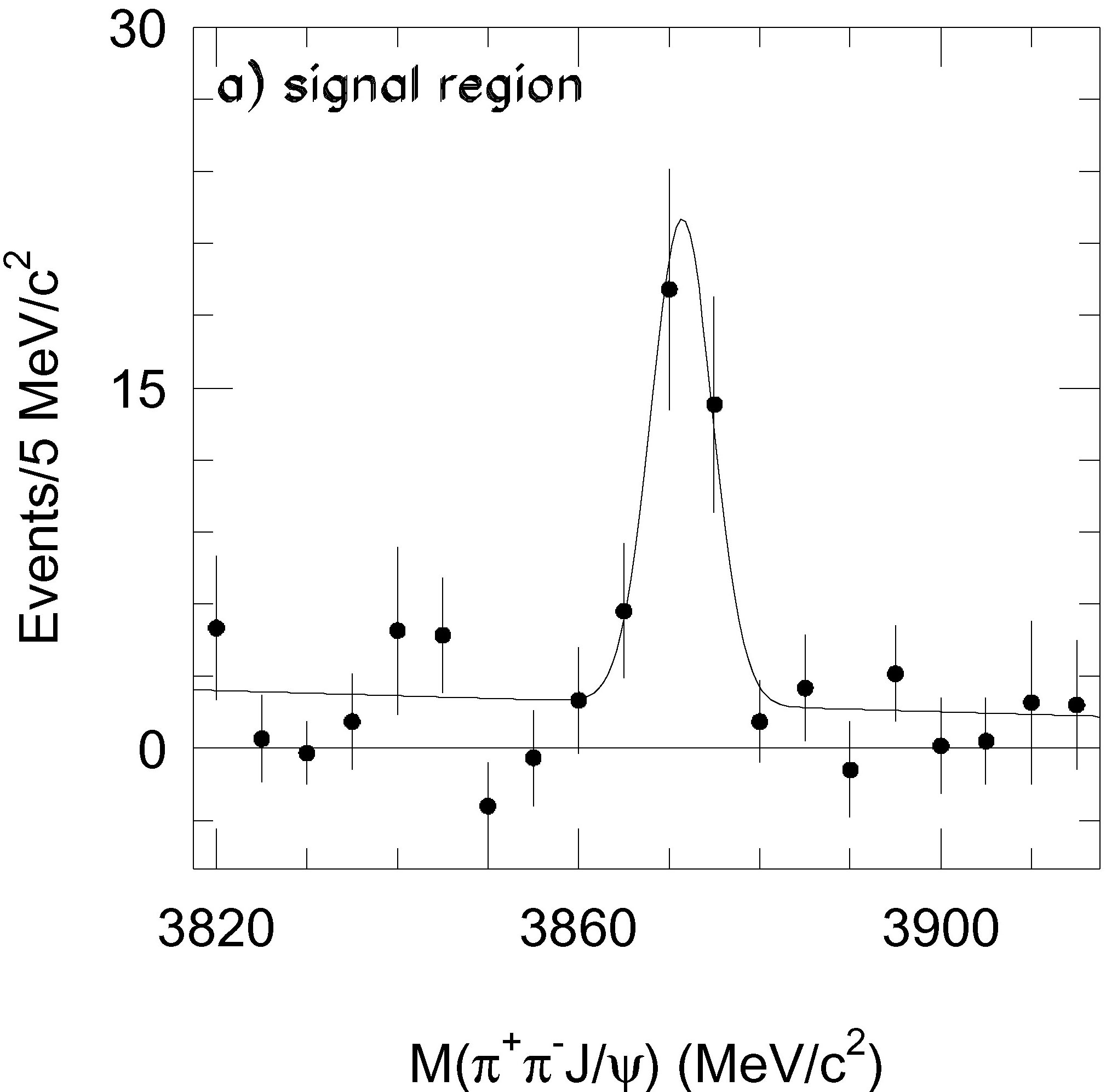
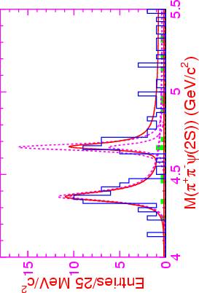
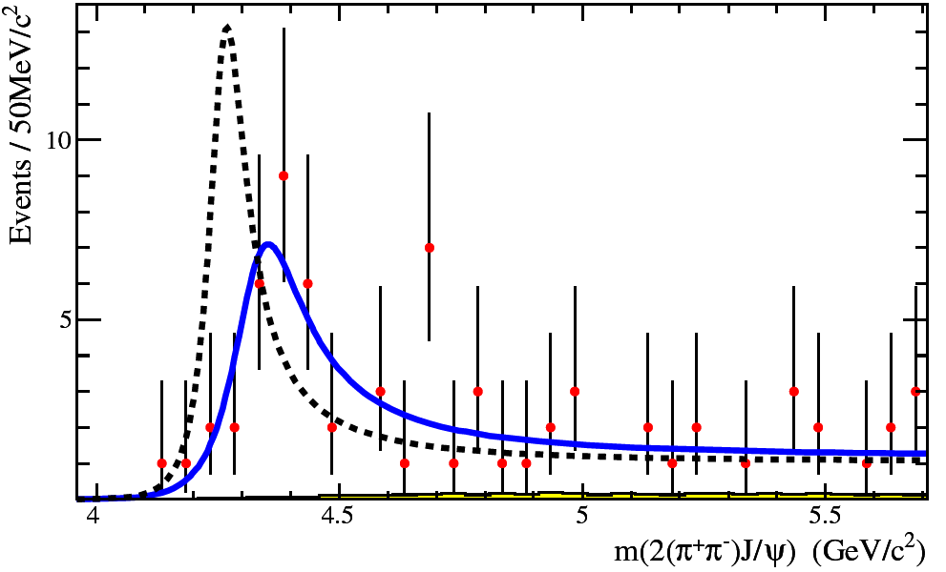
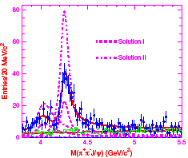
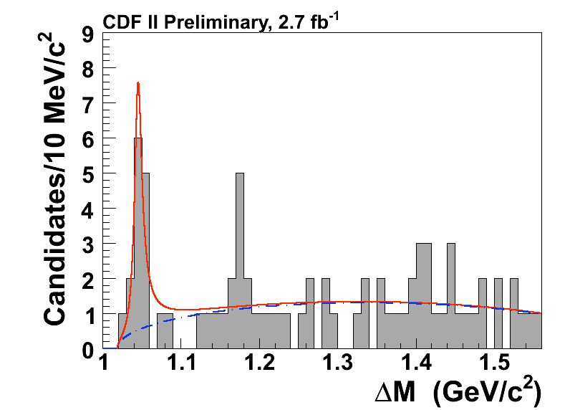
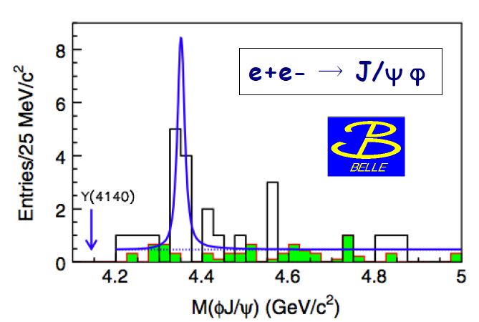
New Charmonium-like Discoveries
X(3872) PRL 91,262001 (2003) | X(3940) PRL 98,082001 (2007) | Y(3940) PRL 94,182002 (2005) | X(3915) PRL 104,092001 (2010)
Y(4260) PRL 95,142001 (2005) | Y(4350) PRL 98,212001 (2007) | Y(4008) PRL 99,182004 (2007) | Y(4660) PRL 99,142002 (2007)
Z(4430)⁻ PRL 100,142001 (2008) | Z₁⁻ & Z₂⁻ PRD 78,072004 (2008) | Y(4140) PRL 102,242002 (2009) | X(4350) PRL 104,112004 (2010)
in addition to many more open charm states
Notes:
Alle anderen Zustaende, die in den letzten Jahren entdeckt wurden und diskutiert werden, habe ich hier zusammengestellt und werde sie nicht einzeln vorstellen …

Slide 20
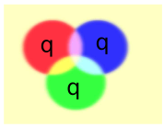
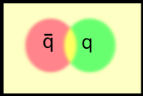
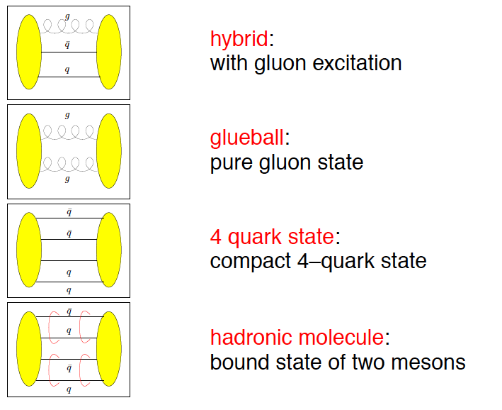
Beyond standard quark configurations
QCD allows much more than what we have observed:
Baryons
Mesons
Exotics:
may have J^{PC} not
allowed for qq
_
Courtesy C. Hanhart

Slide 21
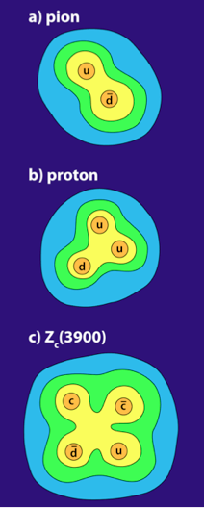
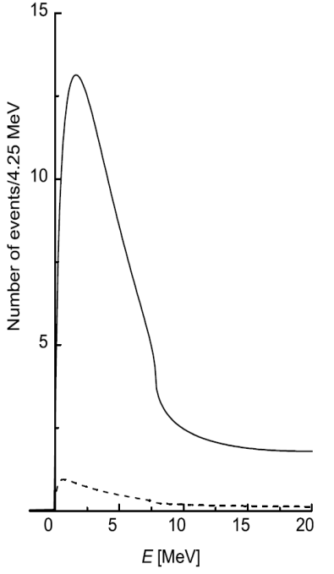
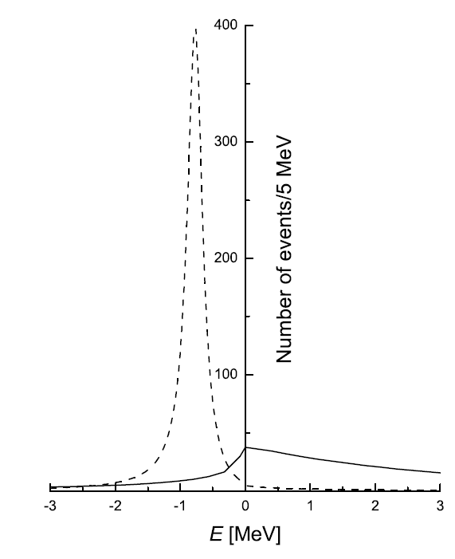
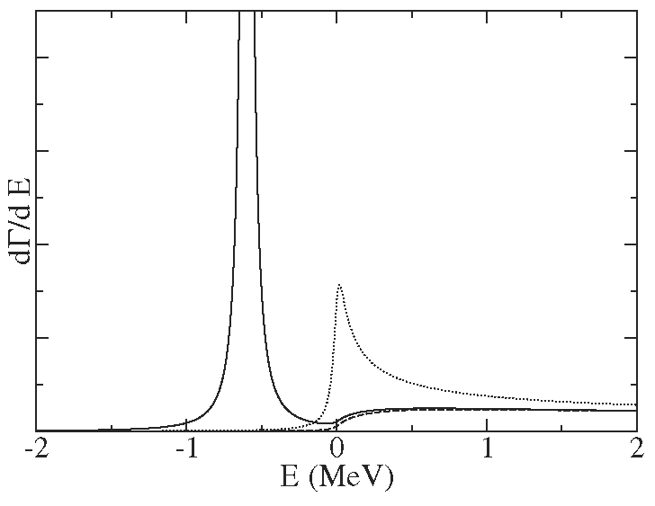
How can PANDA contribute?
J/ψπ⁺π⁻, J/ψπ⁰π⁰, χ_{c}γ → J/ψγγ, J/ψγ, J/ψη, η_{c}γ
direct formation in pp: line shapes !
Exotics: compare formation with production
d target: pn with p spectator tagging, e.g. Z⁻(3900)
_
_
D⁰D^{*0}
D⁺D^{*-}
_
D⁰D⁰π⁰
E. Braaten, M. Lu,
PRD 77 (2008) 014029
J/ψππ
D⁰D^{*0}
peak
cusp
virtual state
binding state
C. Hanhart et al.,
PRD 76 (2007) 034007
Compare lineshapes
in different final states!

Slide 22
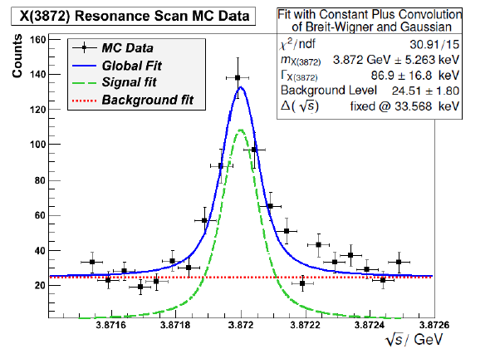
X(3872)
Upper limit on the branching ratio by LHCb
BR(X→pp) < 0.002*BR(X→J/Ψπ⁺π⁻)
And BR(J/Ψπ⁺π⁻) > 0.026 [pdg12]
Implies:
σ(pp→X(3872)) ~ (67 +- ?) nb
_
Γ < 1.2 MeV
_
Here: assume σ=50 nb
“Low lumi” – mode 2x10³¹
Mass resolution < 100 keV
M. Galuska

Slide 23
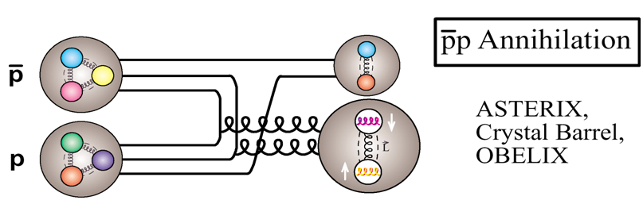
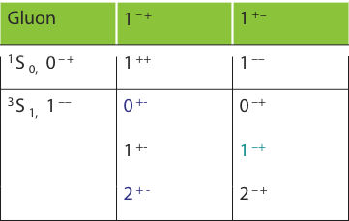
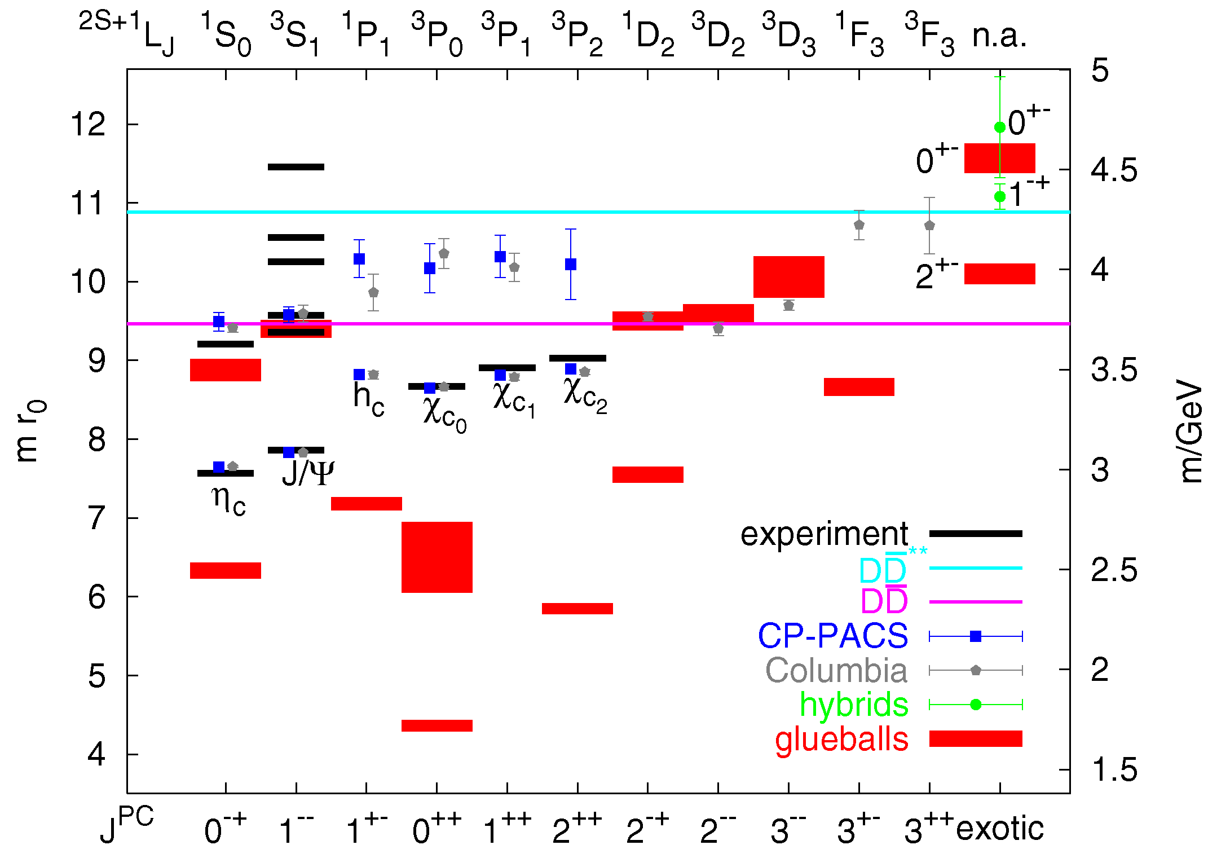
Exotics production in pp collisions
_
Production: all J^{PC} accessible
Hybrids
J^{PC} exotic
Exotic J^{PC} would be clear signal
G.Bali, EPJA 1 (2004) 1 (PS)

Slide 24
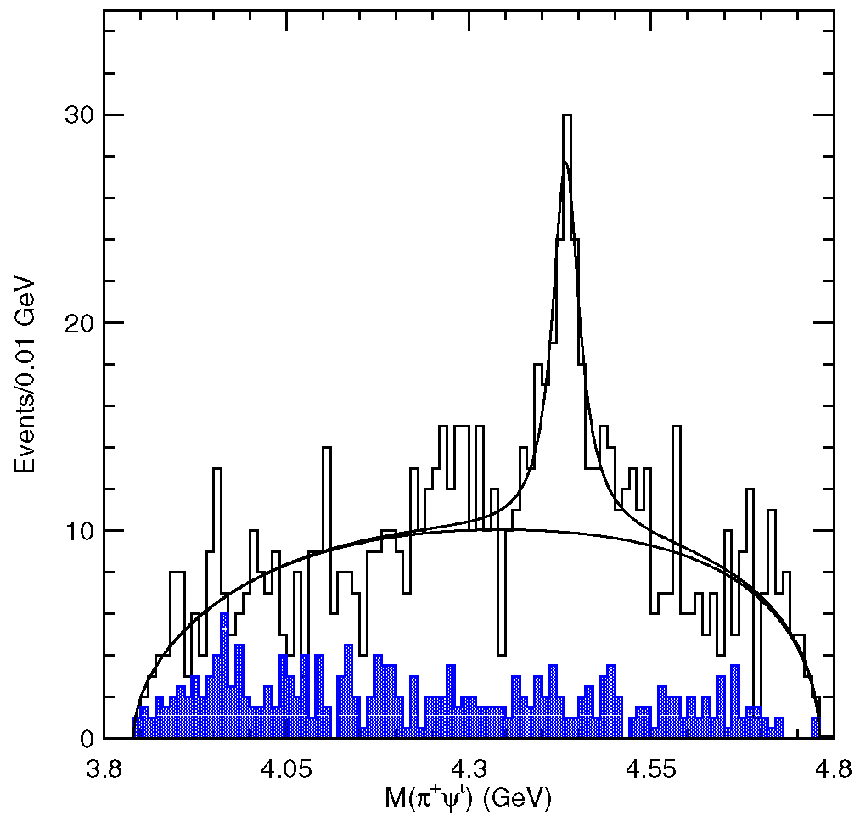
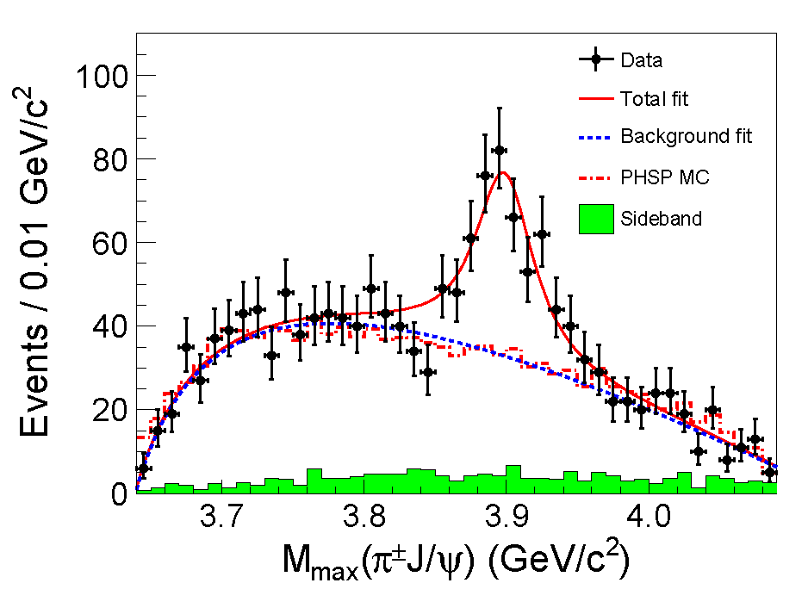
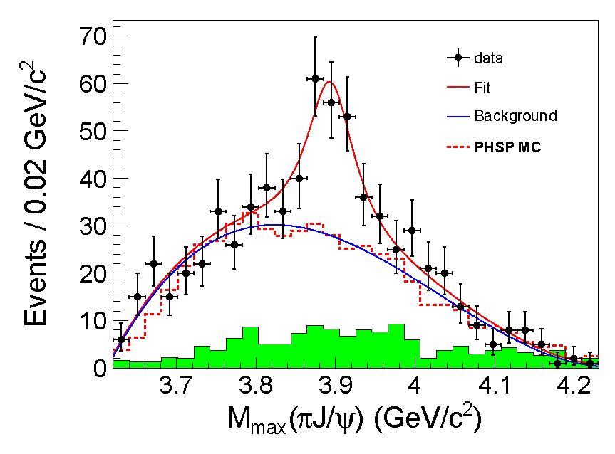
_
_
Non-qq Mesons: Charged cc-like States
Manifestly exotic: tetra-quark or molecular nature
Z(4430)± seen by Belle, not confirmed by BaBar
Z(3900)± seen by BESIII, Belle
X(4050) ±, X(4250) ± seen by Belle
BESIII, arXiv:1303.5949
Belle, arXiv:1304.0121
Belle,
PRL 100 (2008) 142001

Slide 25
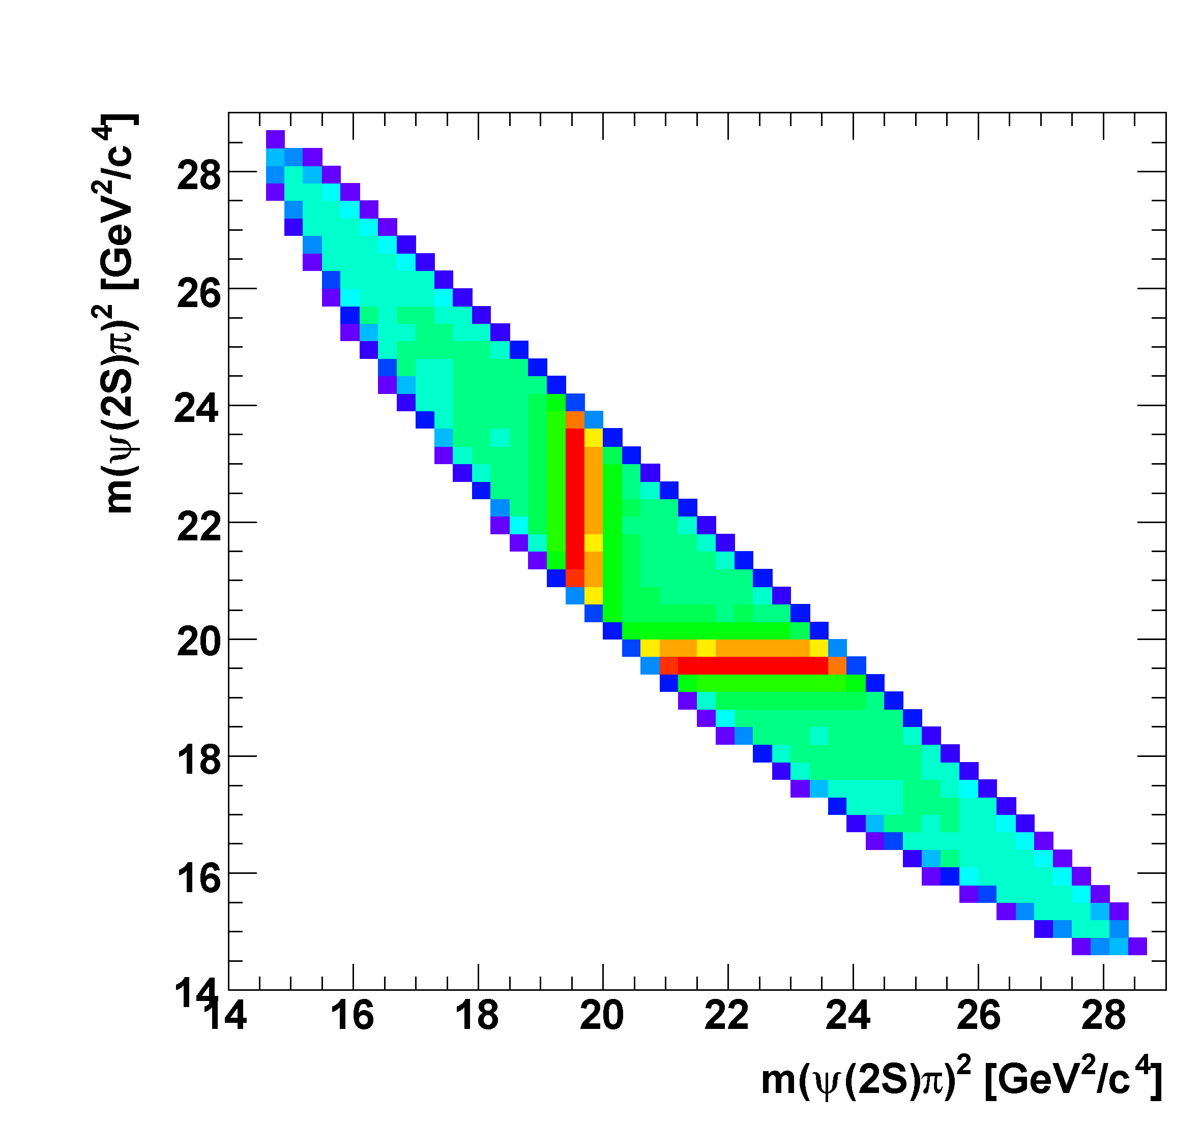
_
_
Non-qq Mesons: Charged cc-like States
Planned studies with PANDA
  production in pp:
  pp → Z(4430)± π
  Z(4430)± → ψ(2S) π± x
  formation in pn:
  pd → Z(4430)⁻ p_{spectator} → ψ(2S) π⁻ p_{spectator}
  must reconstruct the spectator proton
  reduced mass resolution
_
_
±
_
_

Slide 26
Open Charm Spectroscopy with Antiproton Annihilation

Slide 27
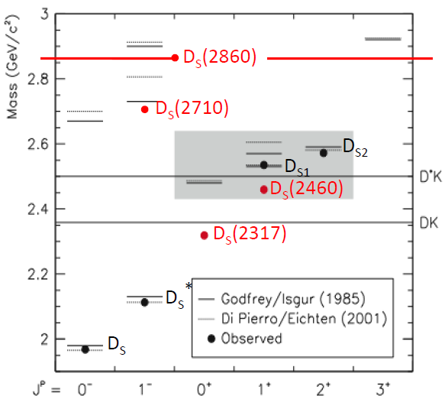
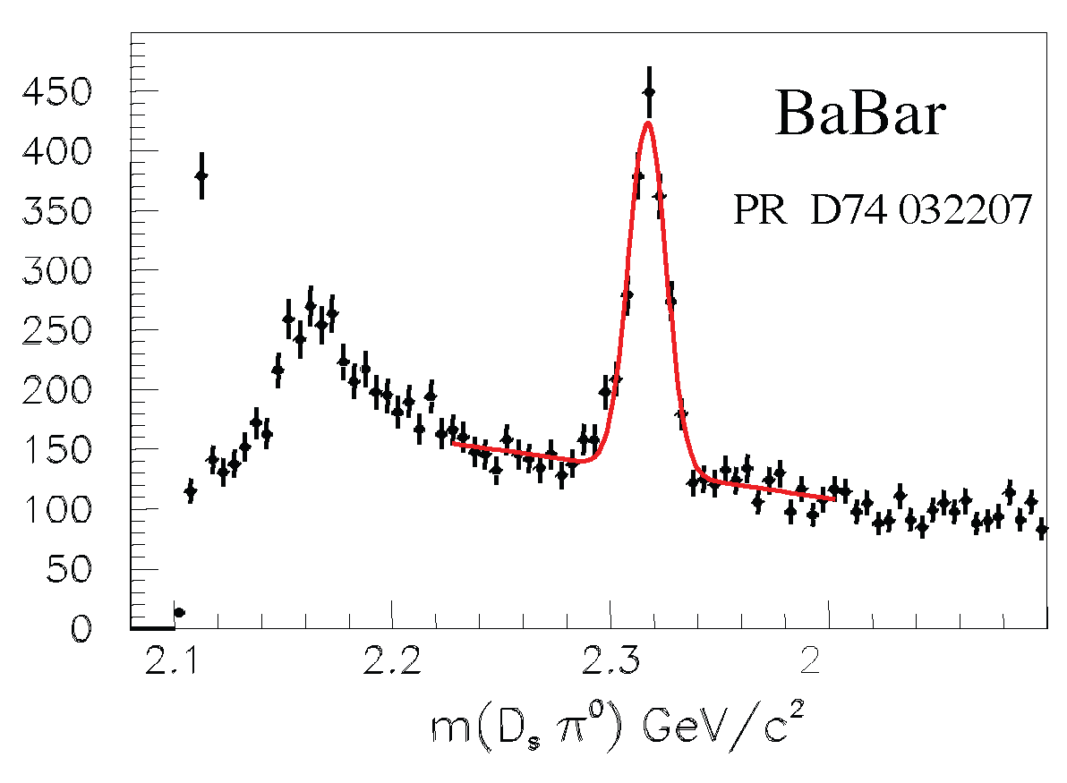
Open Charm: The D_{s} Spectrum
Th./expt. in qualitative agreement for D states, but some details open
Many new D_{J} mesons (e.g. LHCb)
new narrow states (2003):
D_{s}*(2317) and D_{s}*(2460), (and other broader states more recently)
masses significantly lower than quark model expectation, and just below DK and D*K threshold
Widths are only upper limits
Interpretation unclear: DK / D*K molecules, tetraquarks, chiral doublers, …? Sensitive to width

Slide 28
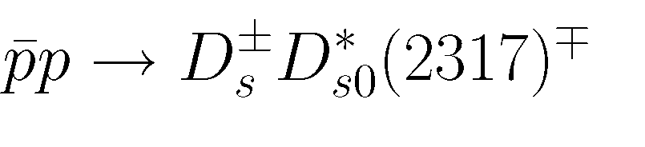


Method: Threshold Scan
reaction:
excitation function only depends on m and Γ of D_{s}(2317)
experimental accuracy determined by beam quality (Δp, σ_{p}/p), not by detector resolution

Slide 29




Simulation Results: Energy Scan
M_{sum} = M_{miss}(D_{s}) + M(D_{s})
Γ = 100 keV

Slide 30

Challenges in Open Charm Spectroscopy
Goals
Cross section measurement
(1-100 nb ?)
Measure width (&mass)
with threshold scan
Mixing between states
with same spin, e.g.
D_{s1}(2460)&D_{s1}(2535)
Chiral Symmetry Breaking
very precise mass
measurement of chiral
partners heavy light system
D_{s0}(2317) & D_{s1}(2535)
D_{s}⁻ Missing Mass
TRUTH MATCHED VALUES
p>50 MeV/c
D_{S}(2460)
D_{s}(2535)
D_{s}(2317)

Slide 31

Semileptonic D_{s} Decays
Semileptonic decay allow precision
measurement of CKM matrix
elements |V_{cd}| and |V_{cs}|
Form factor quantifies transition
FF provides new method to
improve η,η’ mixing angle
Exclusive reco. of both D mesons
Competitiveness requires
full FAIR facility.

Slide 32
Baryon-Antibaryon Spectroscopy with Antiproton Annihilation

Slide 33


Baryon Spectroscopy
_
significant fraction of pp cross section into final state B B + mesons
almost nothing known on excited states of Ξ or Ω hyperons
σ(pp → ΞΞ) ≈ μb
σ(pp → ΩΩ) ≈ 0.1 μb
_
Ξ∗ : 1 ∗∗∗∗
_
_
_
_
Ω∗ : 0 ∗∗∗∗
Quark Model: B. Metsch et al.

Slide 34


Ξ* detection with PANDA
characteristic event topology
σ ~ μb: ~10⁷ Ξ /d produced
final states to be studied: Ξ* → Ξ π, Ξ η, Λ K, Σ K, Ξ(1530) π, Ξ π π, …
benchmark channel: 6.57 GeV/c p p → Ξ⁻ Ξ⁺ π⁰
no empty regions or discontinuities in Dalitz plot
_
_
_
_

Slide 35


Charm Baryons with PANDA
identification challenging
Λ_{c} and Σ_{c} : max E* < 1 GeV
cross section may reach ~1μb, but large uncertainty
predicted narrow hidden charm baryon states
can be searched for with PANDA in N*_{cc} → N η_{c} and N* → N J/ψ decay
J. Haidenbauer, G. Krein, PLB 687 (2010) 314
J.J. Wu et al.,
PRC 84 (2011) 015202

Slide 36

Hadron Interactions:
Double Strange Hypernuclei

Slide 37

Production Mechanism and Detection Strategy

Slide 38
The PANDA Detector

Slide 39

All PANDA Systems
13 m

Slide 40


Target Systems
Clusterjet- or Pellet-Target
Antiproton beam
Interaction point

Slide 41





Target Systems
Cluster target under construction
2x10¹⁵ / cm² @ 2 m from nozzle
Pellet Target with two modes:
  Large pellets → tracking
  Small pellets → uniform lumi

Slide 42

Tracking Detectors
Straw Tube Tracker
Lambda-Disks
Luminosity Detector
GEM Detectors
Forward Tracking System
Micro Vertex Detector

Slide 43



Micro Vertex Detector MVD
Measure open charm and strangeness, improve
tracking resolution, self-triggering continuous readout
Realize strip readout
with PASTA ASIC (modified TOFPET)
Target
Beam
15 cm
40 cm
10 million pixel channels
on 176 modules
200,000 strip channels
on 254 modules

Slide 44



Central Tracker
STT Production under way
Self-supporting→Ultra-lightweight construction
~1% X₀, σ_{r}~140 μm, specific energy loss

Slide 45




GEM Planar Tracker
3 disks in forward polar angles
Detailed design ongoing
Active diameter 900-1500 mm
3 Discs:
≈80 kch = 320 FEB
Pad Plane Support & Media-Distribution
Cooling Support & LV- Distribution
Front-End Electronic
Window
GEM stack
Drift electrode
Shielding Cover
&
Read-out Plane

Slide 46

Forward Tracking Station
3 pairs of tracking stations,
4 double layers of straw tubes each
2 design options for station 6
Very high particle fluxes in stations 1&2
Various prototypes completed
Readout: on track

Slide 47




Luminosity Detector
Measure low-t elastic scattering
Design based on 4 planes of HVMAPS
PANDA

Slide 48

Particle Identification Detectors
Muon Detectors
Forwards RICH
Barrel DIRC
Barrel TOF
Endcap DIRC
Forwards TOF

Slide 49




Barrel DIRC
Photon detectors
and electronics
250cm
Compact design
Profits from late technology
decision (light readout)
Still in R&D (test beams)
100cm
Radiator bars
Focusing optics
PANDA DIRC prototype
in CERN beam line (Aug 2012)

Slide 50



Disk DIRC
Novel, compact PID detector developed
for PANDA suitable for future detectors,
prototype operated successfully
R&D: Photosensors (lifetime)
Readout/DAQ, Mechanics
Glueball decay

Slide 51




Muon Detectors
Barrel, Endcap, Muonfilter, Forward
Various number of layers interleaved
in the yoke
Drift tubes with wire and
cathode strip readout

Slide 52

Calorimeters
PWO Calorimeter
Forward Shashlyk EMC

Slide 53



Target Spectrometer Electro-Magnetic Calorimeter
Rad. hard, fast, largest dynamic
range (cooling)
All endcap crystals produced
Crystals for a barrel slice available
Original producer no longer
available: R&D needed to confirm
alternatives

Slide 54

Magnet Systems
2T Solenoid Magnet
2 Tm Dipol-Magnet

Slide 55
All PANDA Systems

Slide 56
The Computing Challenge

Slide 57

Detector Requirements from Physics Case
High luminosity and hadronic cross sections
High rate capability, 2 · 10⁷ s⁻¹ interactions
High data rate
High degree of radiation resistance
Cross section for electromagnetic Processes

Slide 58


PANDA Trigger
“Trigger-less” DAQ
Software Trigger
Reaction Rate (Hz)
FPGA
Data Size (Byte)

Slide 59


PANDA – Event Simulation

Slide 60
Event Structure
2 · 10⁷ events/s
2000 ns revolution time
40 events per Burst
400 ns gap
Time based simulation by T. Stockmanns

Slide 61

Hitstream Display:
XY-View
Dual Parton Model (DPM):
Standard pp background generator
  Black circles: Early isochrone
  Blue circles: Early skewed isochrone
  Green circles: Close isochrone
  Red circles: Late isochrone
  Black dots: MVD hits
  Green dots: MVD hits r/z > 0.3
  Black+Red dots: Triplets/Skewlets
  Yellow tracks: Timed out track
  Blue tracks: Current track
  DPM Benchmark:
  Realistic event rate
  and structure,
  continuous operation

Slide 62
Summary/Conclusions
Many open questions on how complex structures are derived from underlying degrees of freedom
Antiprotons provide precision measurements
Broad/fascinating physics program at PANDA
Accelerator and detector are on track
➔

Slide 63


The PANDA Collaboration
~ 520 Members, 69 Institutes, 18 Countries
Austria, Australia, Belarus, China, France,
Germany, India, Italy, Poland, Romania,
Russia, Spain, Sweden, Switzerland,
Thailand, Netherlands, USA, UK

