Slide 1
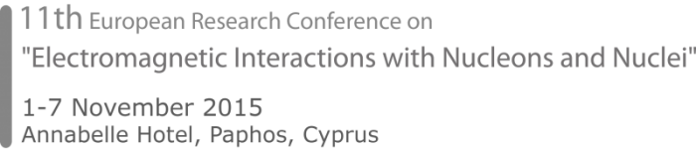




Spectroscopy in the charm range:
from BESIII to PANDA
Stefano Spataro
on behalf the collaborations
ISTITUTO NAZIONALE
DI FISICA NUCLEARE
Sezione di Torino

Slide 2
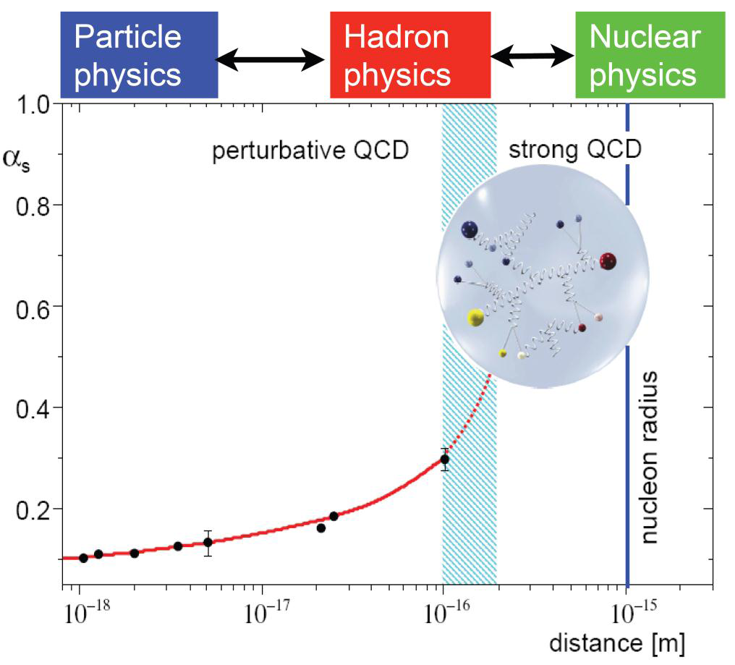
The Fundamental Questions
QCD gives a complete description of the strong interaction
but it leads to equations hard to solve
Confinement: Why are there no free quarks?
Hadron mass: Where is the mass of the proton coming from?
Are there other color neutral objects?
What is the structure of the nucleon?
What are the spin degrees of freedom?

Slide 3
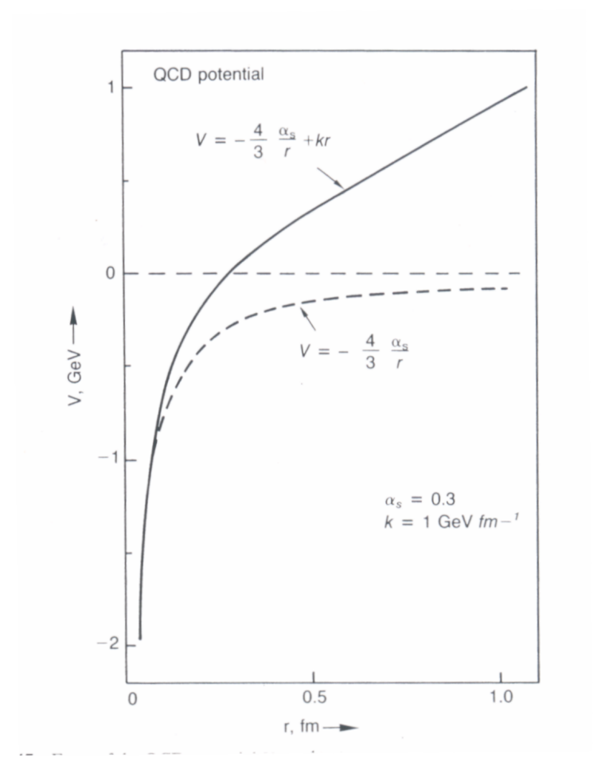
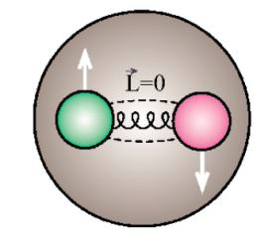
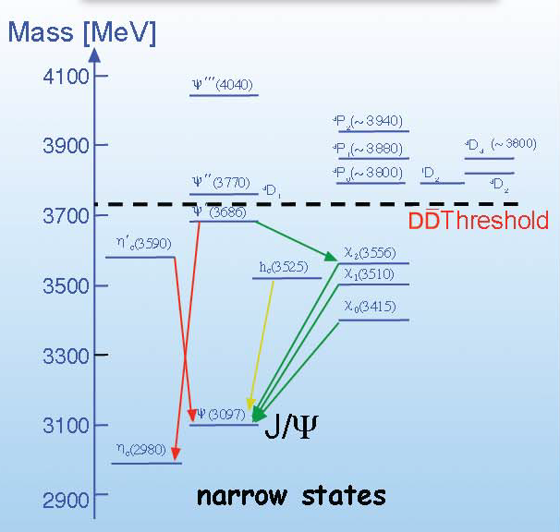
Why Charm(-onium)?
cc system
M_{c} ∼ 1.5 GeV/c²
non-relativistic
potential model
confinement
asymptotic
freedom
Short distance → asymptotic freedom
Large distance → confinement
Charmonium states can be calculated !!

Slide 4
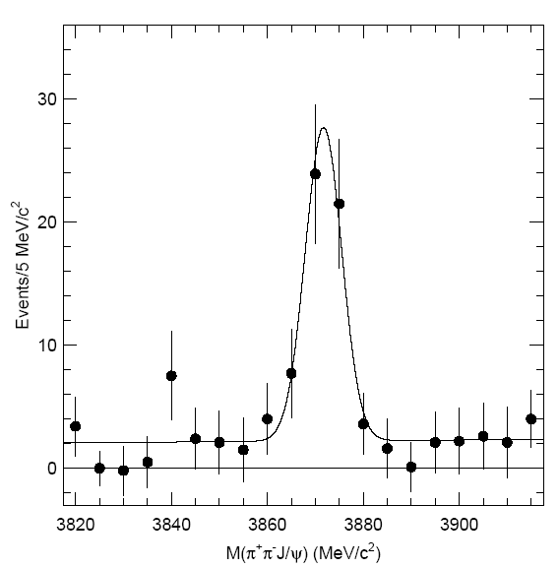
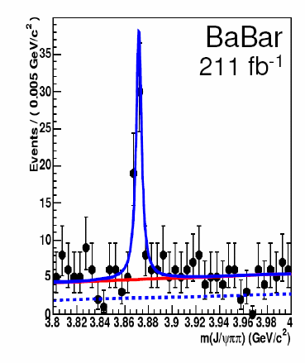

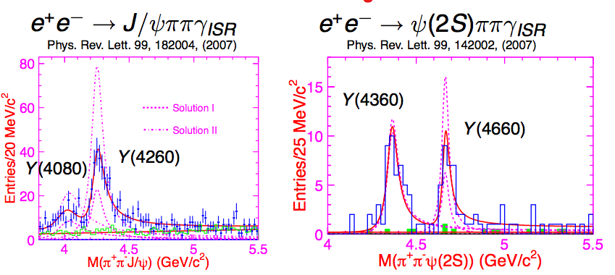
Something “exotic” from B factories
9.4σ
X(3872) unknown state
B-meson decays
J^{PC} → ???
Y unknown vector states
Initial State Radiation
J^{PC} → 1⁻⁻

Slide 5
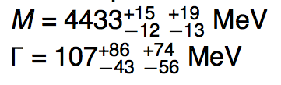
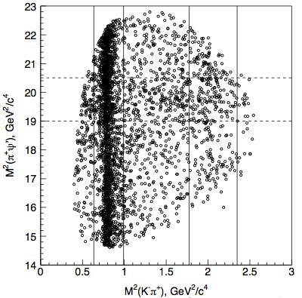
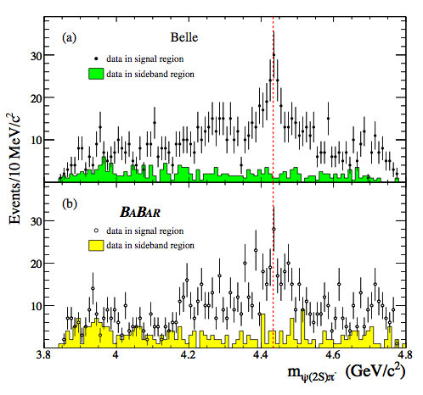
Something more “exotic” (and charged) from B factories
B → K ψ' π± Dalitz plot
PRL 100, 142001 (2008)
Z±(4430)
First charged
charmonium(?) state

Slide 6
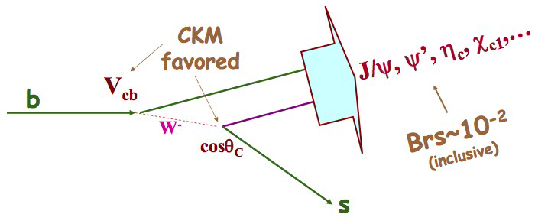
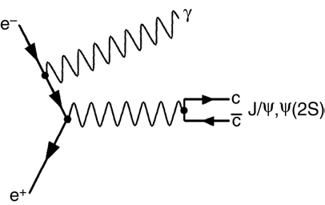
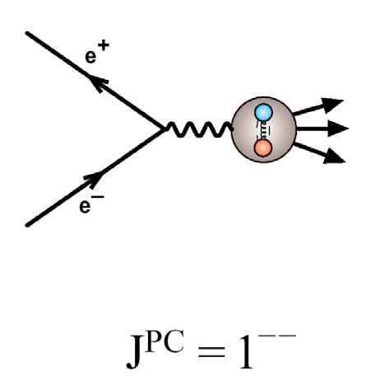
The best ways to study charmonium?
B-meson decays:
Data sample from B-factories
Small production rate
Very clean environment
Any quantum number
c
c
Initial State Radiation in e⁺e⁻ collisions:
A photon is radiated before annihilation
Lower center-of-mass energy
Only 1⁻⁻ states
R scan
Direct formation in e⁺e⁻ collisions:
Charm factories
Formation of 1^{–-} states
Production of other states by cc decays
γ*
cc
two-photon fusion, double charmonium…

Slide 7
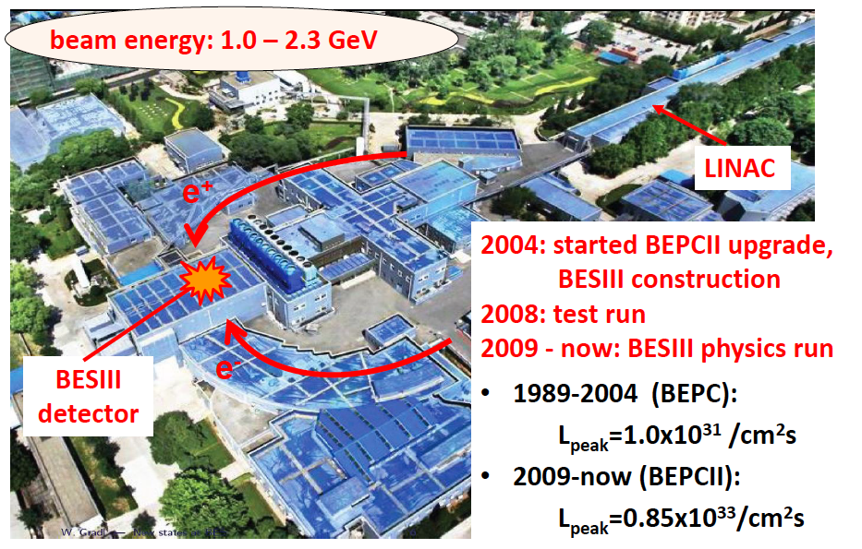
The Beijing Electron-Proton Collider BEPC-II

Slide 8
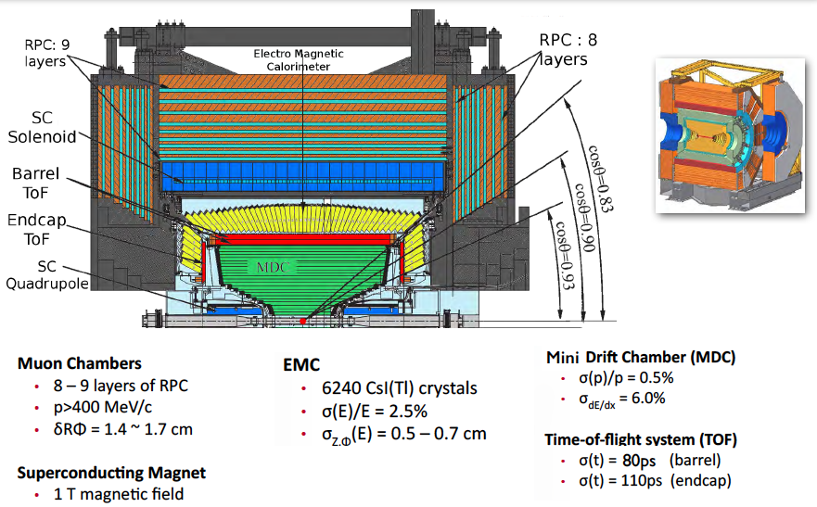
The Beijing Spectrometer

Slide 9
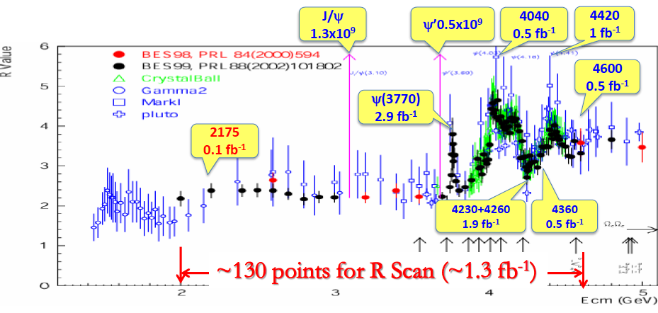
The Data Sample
World largest data sample on J/ψ, ψ(2S), ψ(3770),Y(4260)… in e⁺e⁻ collisions
From light mesons spectroscopy to Λ_{c}Λ_{c}
Also ISR, photon-photon physics, τ physics…

Slide 10
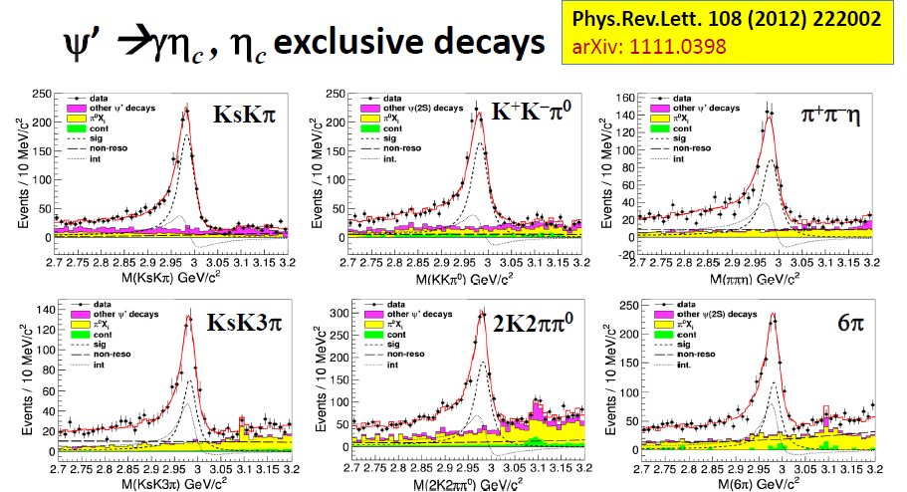
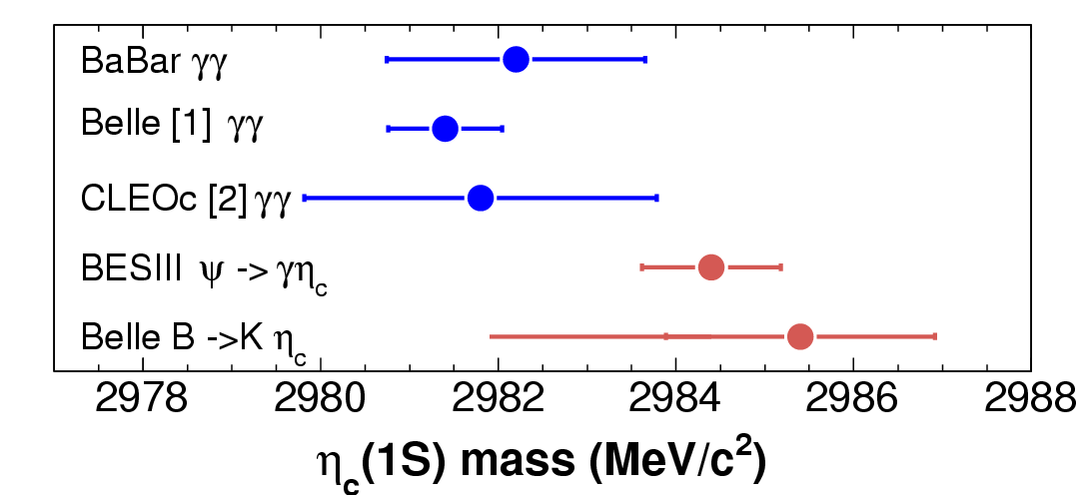
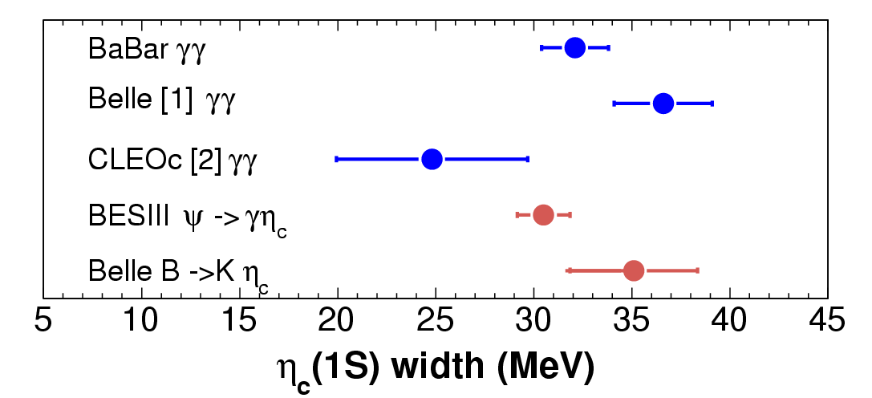
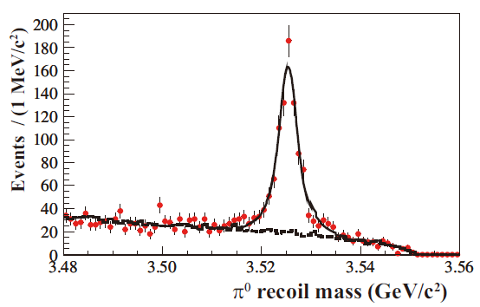
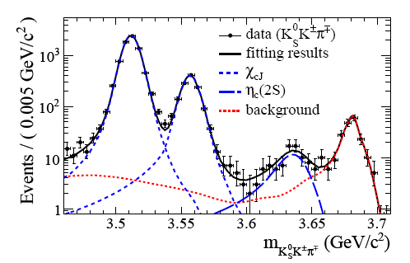
Charmonium Spectroscopy below DD Threshold
M(_{c}) = 2984.3±0.6±0.6 MeV/c²
Γ(_{c}) = 32.0±1.2±1.0 MeV
η_{c}
PRD 86, 092009 (2012)
h_{c}
η_{c}(2S)
PRL 109, 042003 (2012)
M(h_{c}) = 3525.31±0.11±0.14 MeV/c²
(h_{c}) = 0.70±0.28±0.22 MeV
M(_{c}(2S)) = (3637.6±2.91.6) MeV/c²
Γ(_{c}(2S)) = 16.9±6.4±4.8 MeV

Slide 11
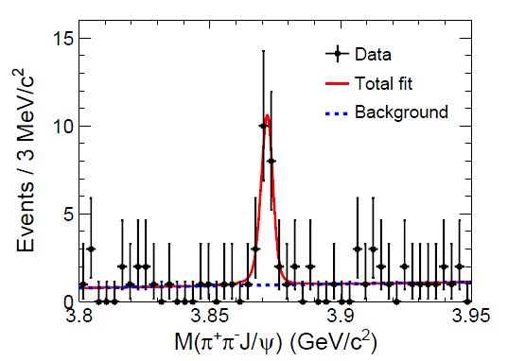
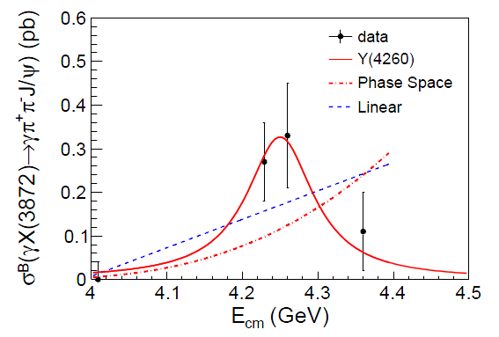
X(3872) in
e⁺e⁻ → γX(3872) @ 4.23, 4.26, 4.36 GeV/c²
X(3872) → ππJ/ψ
PRL112 (2014) 092001
6.3 σ significance summing all data
Radiative decay of Y(4260)?
More statistics needed
M[X(3872)] = 3871.9 ± 0.7 ± 0.2 MeV
Γ < 2.4 MeV @ 90% C.L.
J^{PC} 1⁺⁺ from LHCb

Slide 12
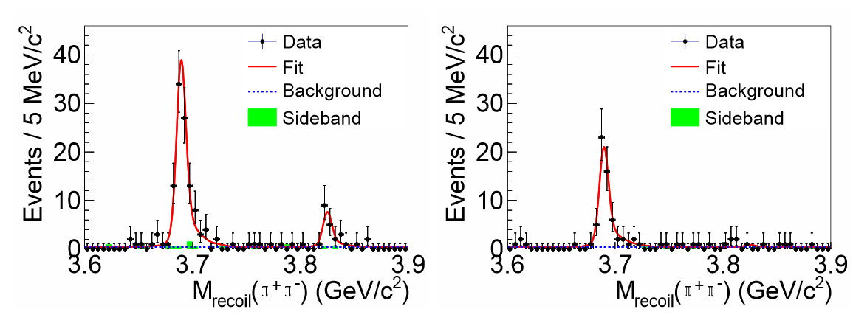
X(3823) in
e⁺e⁻ → π⁺π⁻X(3823), X(3823) → γχ_{cJ}, χ_{cJ} → γJ/ψ
PRL 115 (2015) 011803
Simultaneous fit of 𝜸𝝌_{𝒄𝟏} (left) and 𝜸𝝌_{𝒄𝟐} (right) events
M[X(3823)] = 3821.7 ± 1.3 (stat) ± 0.7 (syst) MeV/c²
Γ[X(3823)] < 16 MeV at 90% C.L. consistent with Belle
Ψ(1³D₂)

Slide 13
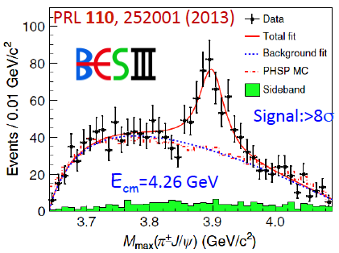
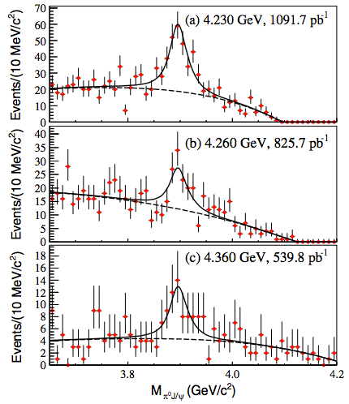
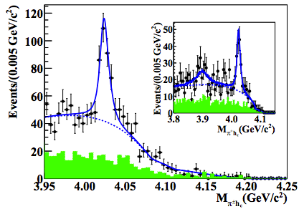
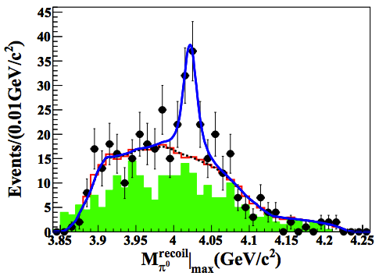
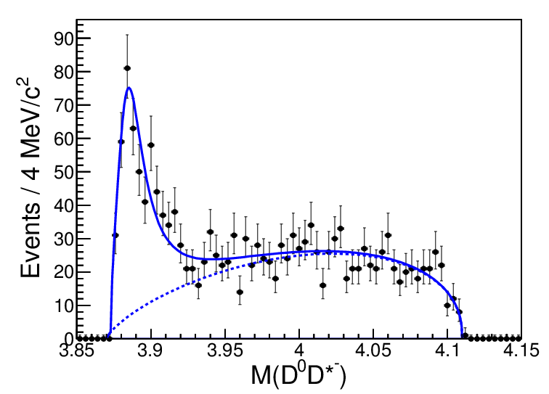
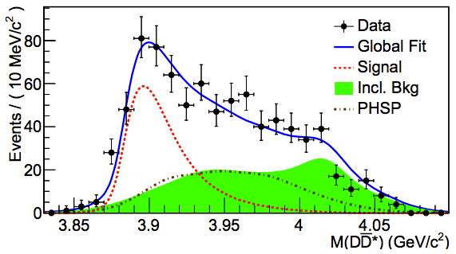
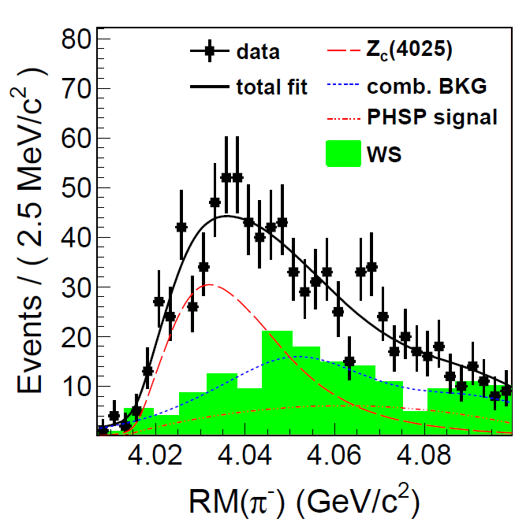
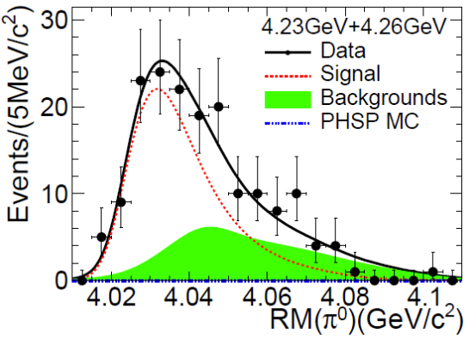
Z: Charged Charmonium-like States in
PRL 115, 112003 (2015)
PRL111, 242001(2013)
PRL 113, 212002 (2014)
e+e⁻→π⁻π⁺J/ψ
e+e⁻→π°π°J/ψ
e+e⁻→π⁻π⁺h_{c}
e+e⁻→π°π°h_{c}
arXiv: 1509.05620
PRL112,132001(2014)
arXiv: 1507.02404
PRL 112, 022001 (2014)
e+e⁻→π±(DD*)∓
e+e⁻→π°(DD*)°
e+e⁻→π±(D*D*)∓
e+e⁻→π°(D*D*)°
Z_{c}(3900)⁺?
Z_{c}(3900)°?
Z_{c}(4020)⁺?
Z_{c}(4020)°?
States observed in open-charm and pion decays with compatible masses
Two isospin triplets in two different decay modes?

Slide 14
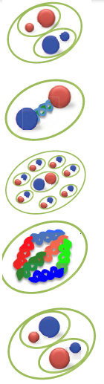
Exotics from QCD
Tetraquark
compact object formed by (Qq) and (Qq)
Hybrid
compact object formed by (QQ) and gluons
Hadro-Quarkonium
compact (QQ) surrounded by light quarks
Glueball
compact objects made only by gluons
Hadronic molecule
extended object formed by (Qq) and (Qq)
…and do not forget pentaquark!!!

Slide 15
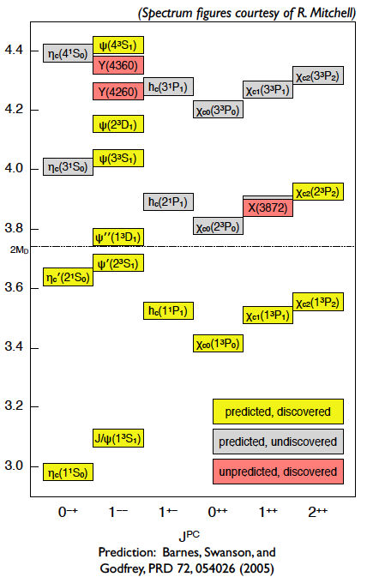
The situation is quite far from being solved
Levels below open charm threshold
“well understood”
Levels above open charm threshold
the situation is more complex!
Missing predicted states undiscovered
Unpredicted states discovered
?
Low production rates for states J^{PC} ≠ 1⁻⁻
Impossibility to measure small widths
Higher spin states suppressed

Slide 16
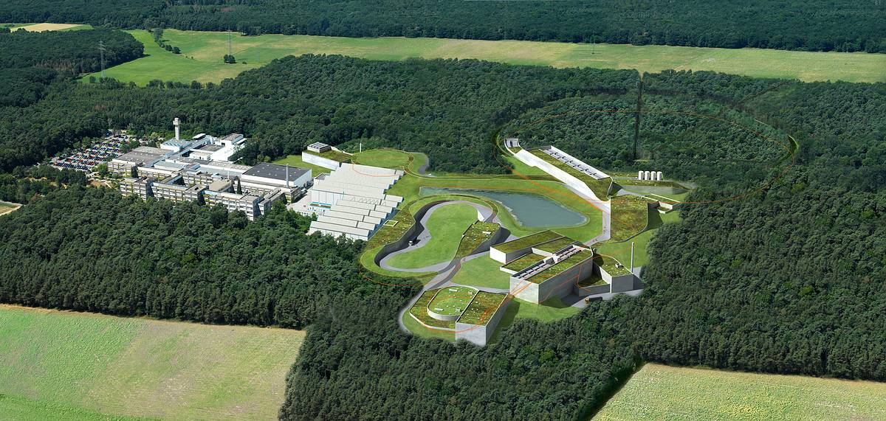
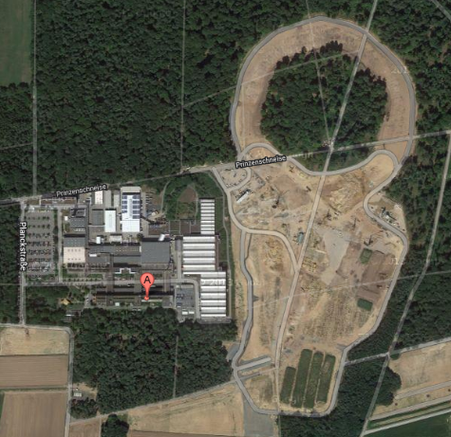

Facility for Antiproton and Ion Research
Darmstadt (Germany)
GSI
High intensity mode
L = 2·10³² cm⁻² s⁻¹
σ_{p}/p = 10⁻⁴
Electron cooling
High resolution mode
L = 2·10³¹ cm⁻² s⁻¹
σ_{p}/p < 5·10⁻⁵
Stochastic cooling
High Energy Storage Ring
10¹⁰-10¹¹ antiprotons
p = 1.5 – 15 GeV/c

Slide 17
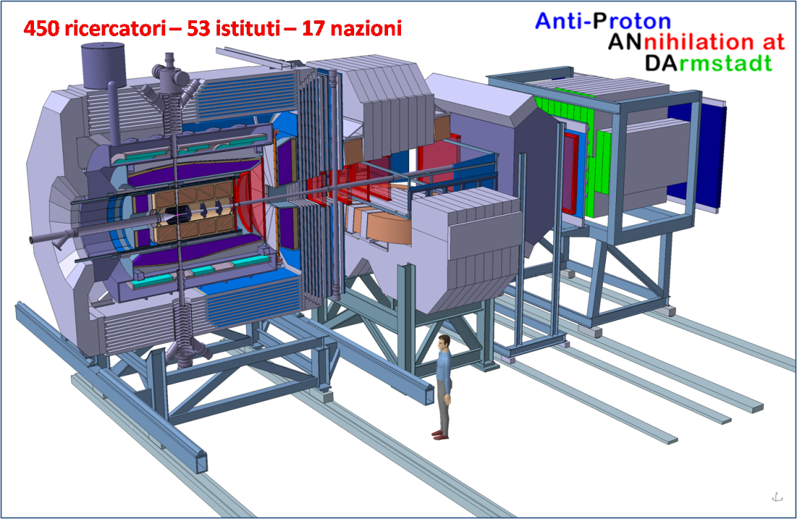
The PANDA Experiment
pp, pA collisions
1.5⇒15 GeV/c (p momentum)

Slide 18
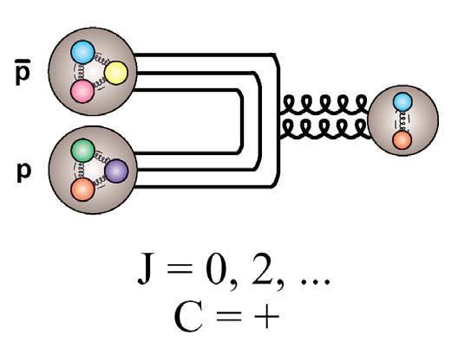
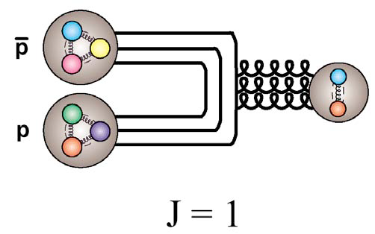
What about proton-antiproton collisions?
In e+e- collisions:
Formation only of 1– states
Production of other states by decays
Width measurements dominated by detector resolution
In proton-antiproton collisions:
Annihilation of all the quarks
All quantum number accessible
Rich gluon environment
Width measurements dominated by beam resolution

Slide 19
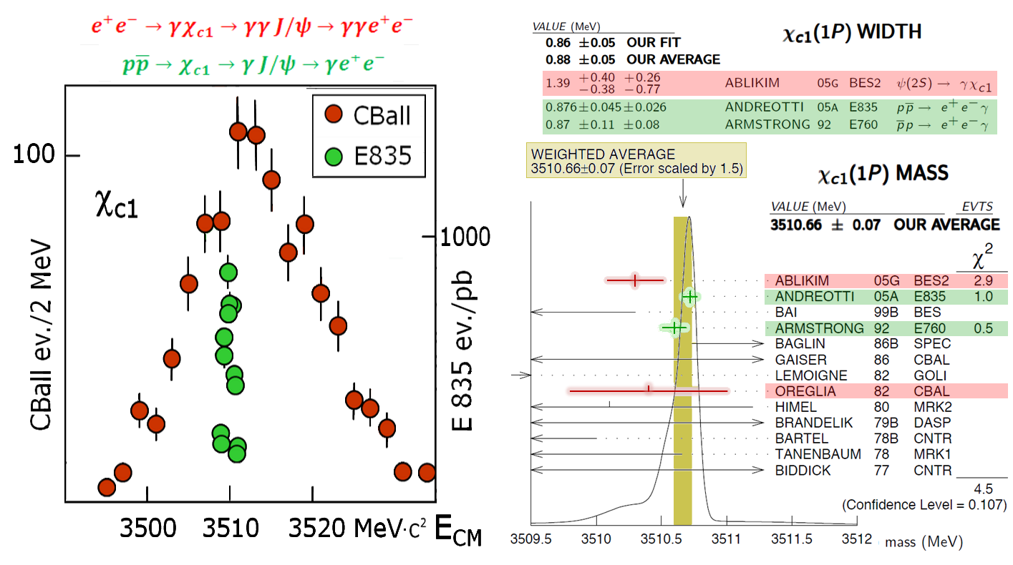
Demonstration: the χ_{c} case

Slide 20
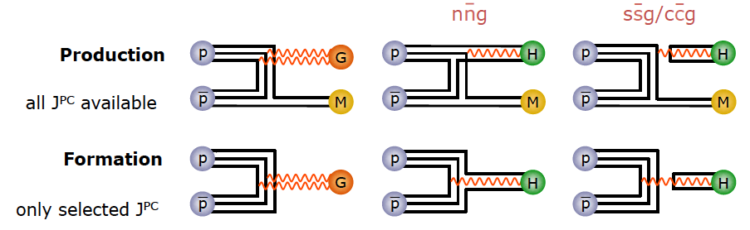
Rich gluon environment
Gluon rich process creates gluonic excitation in a direct way
Access to both exotic and non-exotic quantum numbers
Highest precision for direct formation
Access to both light and charm energy range
UNIQUE to PANDA

Slide 21
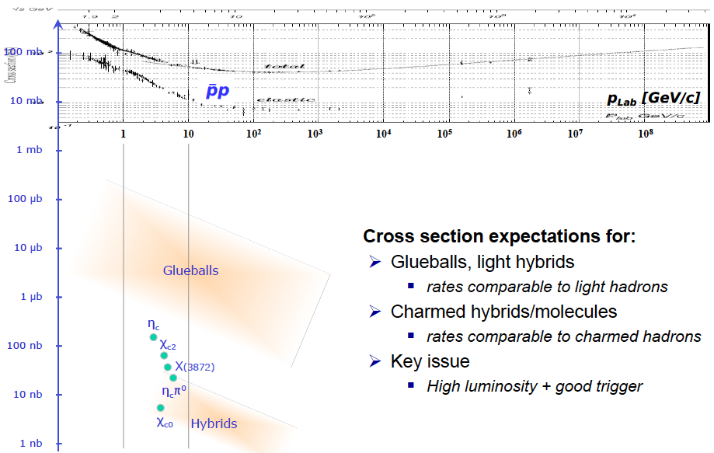
Rich gluon environment!

Slide 22
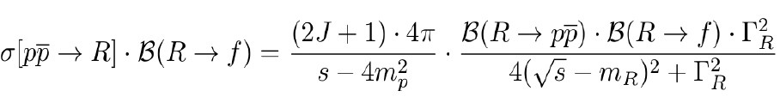

XYZ rates in PANDA
Detailed balance method
Scaling widths if unknown
<<<
Resonance | Cross Section | High Luminosity 8.64 pb⁻¹/day | High Resolution 0.864 pb⁻¹/day
X(3872) | 50 nb | 432000 | 43200
Y(4260) | [0.077 – 2.2] nb | 665 - 19000 | 67 – 1900
Z(3900)⁺ | [0.017 – 0.473] nb | 140 - 4050 | 14 – 405
For comparison:
Belle: ~1500 X(3872) in 4 years
BESIII: ~1200 Y(4260) per day, but ~20 γX(3872) events in ~4 weeks

Slide 23
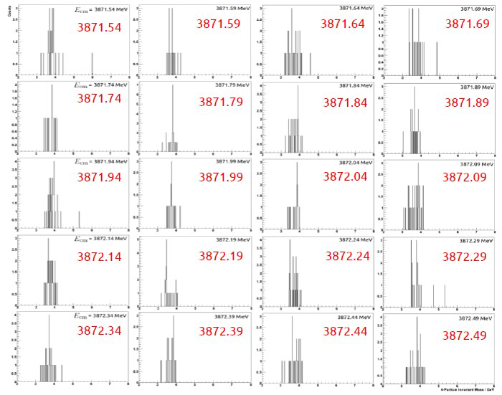
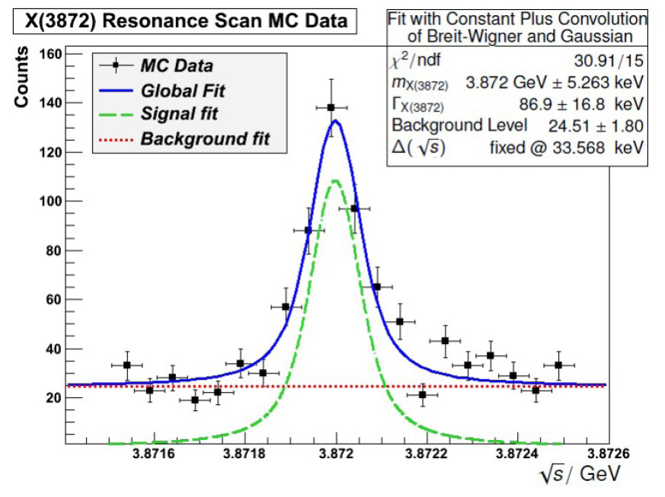
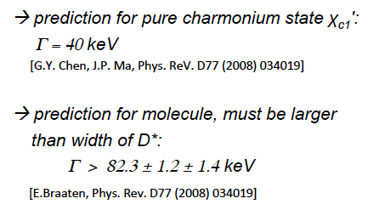
X(3872) lineshape scan in PANDA
40 days of data taking
Goal: Width measurement of X(3872)
20x better resolution than B-factories (challenge 50-100keV)
PDG upper limit: Γ<1.2 MeV @ 90% C.L.

Slide 24
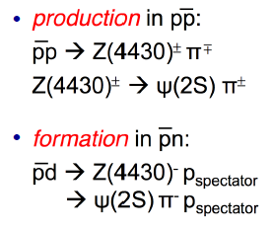
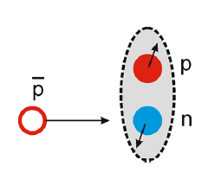
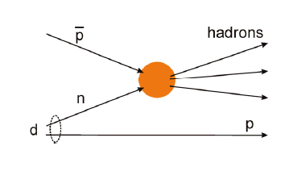
Z states in PANDA?
Antiproton-deuteron collisions
neutron almost on-shell
proton is a ‘spectator’ p ~ 50 MeV/c
spectator proton not visible
UNIQUE with PANDA

Slide 25



Search for states with high angular momentum
Test of flavor independence
High L suppressed in e+e- factories
2 ¹P₁ state partner of h_{b}’ (Belle)
Large width, close to thresholds
1 ³F₄ no partner observed
Suppressed in e+e- factories (J=4)
2 ¹P₁ (h_{c}’)
1 ³F₄

Slide 26

What about open charm?
Light-Heavy
system
Degenerate states with respect to c spin degree of freedom
Total J of light quark is conserved
D_{sJ}(2860)
Problems in explaining the masses of all known D_{s}…

Slide 27




D_{s0}*(2317) in PANDA
Precise measurement of mass and width
Theoretical interpretation sensitive to Γ
Energy scan with recoil @ threshold
Width determination better than 100 keV seems feasible

Slide 28




Di-baryons in pp collisions
Intrinsic control of systematic errors
Identical pattern in c.c.
No need to produce extra mesons (for S/C balance)
Large cross sections
preliminary estimations with low luminosity
Spin physics with excellent prospects:
ΛΣ with high rate, low background
Ω study feasible
Λ_{c} requires high luminosity

Slide 29

Potential PANDA Plan in the first 2 years
Reduced luminosity
Max 2·10³¹ cm⁻²s⁻¹

Slide 30
Summary
Exciting (and exotic) new physics from charmonium region
towards a better understanding of strong interactions
BESIII is collecting a huge amount of data in the charm region
Charmonium below DD threshold well established
New states with “anomalous” features above DD
Color neutral objects different from qq do exist!
PANDA will perform high quality spectroscopy
Gluon rich environment → high event rate
Formation → Precise measurements of widths
Discovery potential very high!

Slide 32

Intepretations of D_{s0}*(2317)

